Slide 1
Adding Wins while Migrating Sites

Slide 2

I am Michael Sheldon
College of Design, Georgia Tech
Sr Application Developer &
Communications Technology One-Stop Shop
Appearances since <blink> :
Sports (that other place off 10th St)
Medicine
Government
Finance
EDU & Research
Non-Profits & Religious
Agency
Bartending (just the best stories)

Slide 3
College of Design
Schools
Architecture
Building Construction
City & Regional Planning
Industrial Design
Music
And a whole bunch of labs
Research Centers
AMAC Accessibility Solutions & Research Center
Center for Assistive Technology and Environmental Access (CATEA)
Center for Geographic Information Systems (CGIS)
Center for Music Technology (CMT)
Center For Quality Growth and Regional Development (CQGRD)
Digital Building Laboratory (DBL)
SimTigrate Design Lab
Notes:
AMAC & CATEA highlight

Slide 4

This presentation is NOT about the Migrate module
Seriously, there are plenty of presentations on JUST that

Slide 5
For example
Drupal 8
DrupalCon Vienna: Migrate Everything into Drupal 8
https://events.drupal.org/vienna2017/sessions/migrate-everything-drupal-8
DrupalCon Baltimore: Migrate All the Things
https://events.drupal.org/baltimore2017/sessions/migrate-all-things
Evolving Web’s Drupal 8 Migration: Migrating Basic Data
https://evolvingweb.ca/blog/drupal-8-migration-migrating-basic-data-part-1
Using the Migrate Source CSV Module
https://www.drupal.org/docs/8/modules/migrate-source-csv/using-the-migrate-source-csv-plugin
Stop Waiting for the Feeds Module: How to Import RSS in Drupal 8
https://ohthehugemanatee.org/blog/2017/06/07/stop-waiting-for-feeds-module-how-to-import-remote-feeds-in-drupal-8/
Drupal 7
Introduction to the Migrate Module Series
https://drupalize.me/videos/introduction-migrate-module-series?p=1271
Notes:
LOTS more regarding various parts of Migrate – JSON, images, taxonomy etc
Mediacurrent, Acquia, Chromatic, etc

Slide 6

What we ARE going to cover
Cause this is why you are here

Slide 7

Topics Include
Why oh why migrations
Editorial & stakeholder buy-in
Design and presentation changes
Increasing content uptake
Accessibility & legal issues
A little fun tech improving UX
Notes:
These WILL overlap depending on process and involvement

Slide 8

Why, oh why, Migrations
Can they be more than just a pain

Slide 9
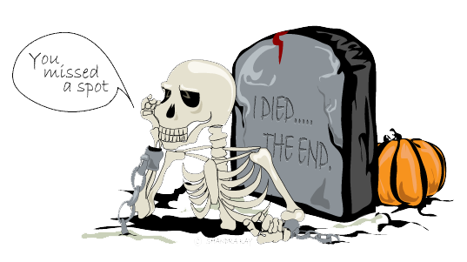
Why do you migrate sites?
Obsolete technology
    Security issues, training, institutional memory fading
New / company-wide initiative
    Consistency, reducing long term costs, rebranding
Old project given new life
    Funding acquired, key personnel return, timely
You got hacked
    Well crap. Good luck and hope you had back-ups
Notes:
Each has own timeframes and issues – eg hacked vs long term rebranding and updating

Slide 10
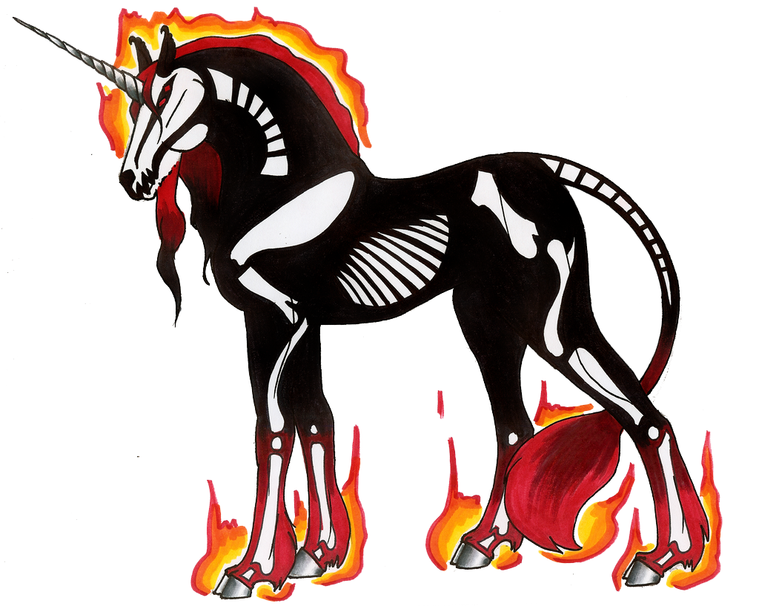
The Unicorn
The mythical migration of a small, simple, site which can be cut and pasted into a new CMS with large, direct, documentable time and cost savings.
Notes:
Expect these sites to be gone or archived now
BUT URBAN CLIMATE

Slide 11
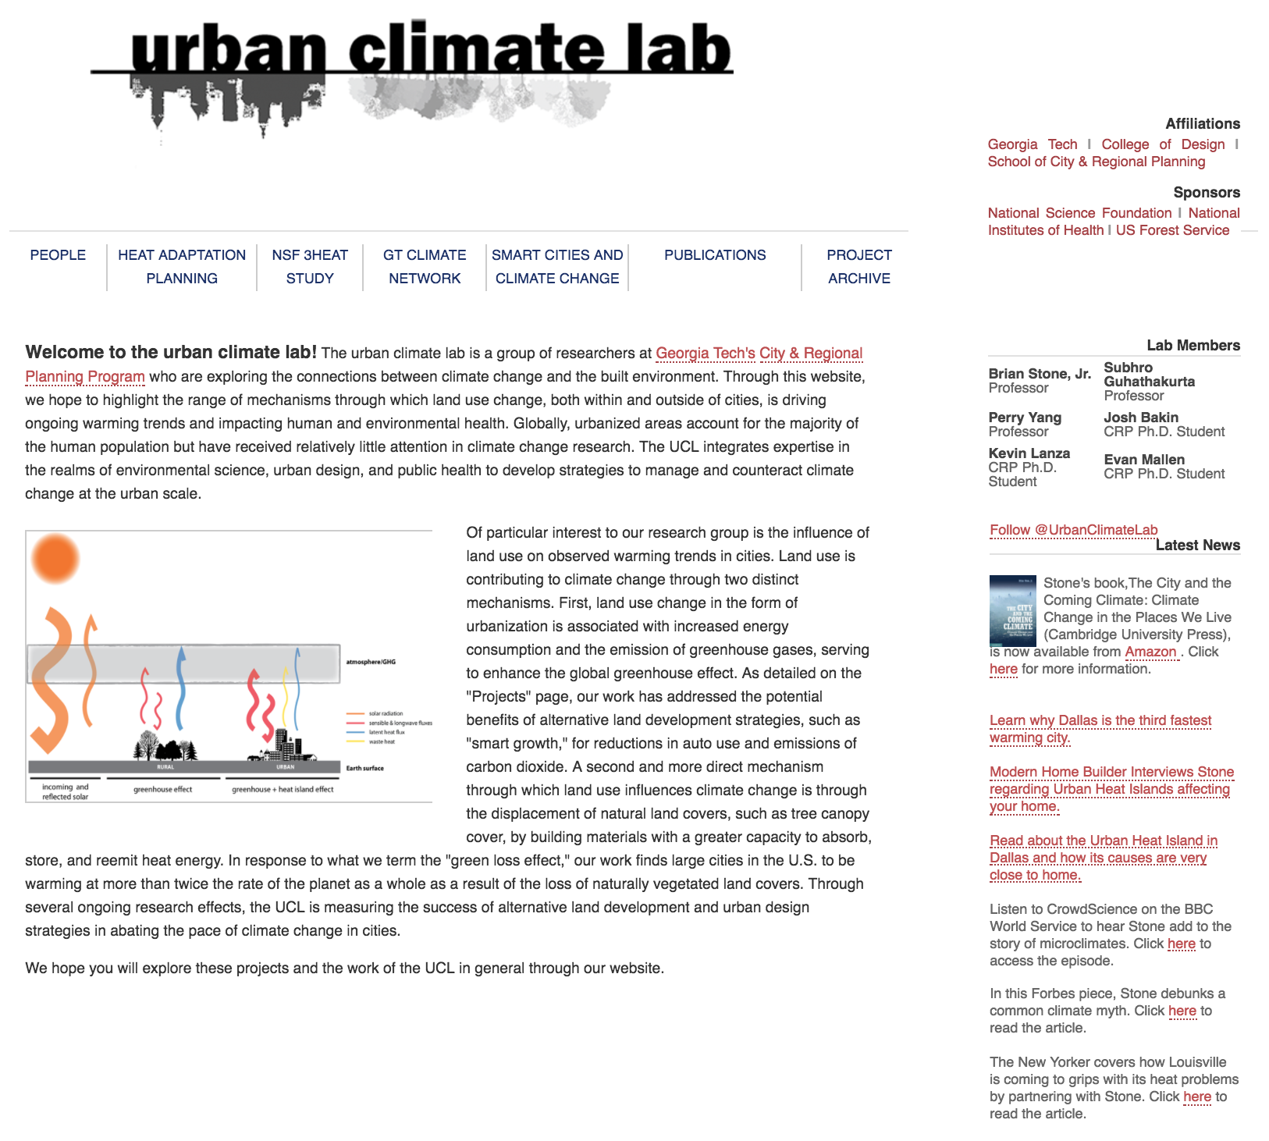
It Does Exist!
Notes:
Quick description on edits with grad student and move to WP multisite on PWP for about 10 page site

Slide 12

Buying time to get more out of your migration
Make stakeholders see the light.

Slide 13

Stakeholder Buy-In
Give them data in the form they need
          Graphics for visual folks
          Statistics & numbers for accountants and engineers
          Stories for sales, marketing, and editors
Initially include ALL stakeholders
People would rather recuse themselves then feel left out of the process
Stay benefits focused
    Yes you’ll add time and costs, but they SHOULD have a greater ROI
Own the risks
Being blind-sided later will harm the process and future projects
Start early
    Learn objections and concerns upfront so they can be addressed
Notes:
Stories for sales and marketing

Slide 14

Editorial, Content, and Design
Speak goodly and look awesome.

Slide 15

The average website life span is 2 years, 7 months
Via Alexa top 200, Wayback Machine https://www.orbitmedia.com/blog/website-lifespan-and-you/
Notes:
While migrating—how much has changed? Is the existing content you have still worthwhile to be just directly ported over
NOT for rush jobs
Varies by industry 6 months to 5 years

Slide 16

Typical Editorial Concerns
Change is scary for most editors
    They have time invested in a system and usually aren’t as technical
Training impacts current deadlines
    This is where management support is so important
They know concerns you don’t
    Be open to adding and addressing new issues
Discuss how decisions will be finalized
    Try not to leave this to org charts or technical hand waving
Notes:
Fire hose approach vs targeted
process

Slide 17

Editorial Change Process
Always reinforce how important content producers are to the result
    Most are not full-time editors
Discuss and watch work flows
    Seriously, sit down with them and get their feedback from start to finish
Content consumption has changed
    It’s not been just volume of pages for a while now
Train editors on standards & tech
    Lead, don’t leave them flustered. Highlight how new skills help them
Notes:
Fire hose approach vs targeted
process

Slide 18

Editorial Review Process Benefits
Content produced in a single voice
    No jarring changes in styles between pages or even sections
Targeted Messaging
    Paragraph, sentence, keywords all align
Perspective and clarity
    Technobabble and firehose effect reduced
Notes:
Fire hose approach vs targeted
process

Slide 19
Editorial Training Examples
Avoid italics and underline
    Outside of bibliographies, they make text online more difficult to read
D o n ’ t f o r c e j u s t i f y t e x t
    Spacing confuses word and line breaks for everyone, not just dyslexics
Avoid long, unbroken paragraphs
    Images and white space help legibility
Sans vs serif fonts for body text
    Display levels can use either, but sans is easier reading in text blocks
    http://uxmovement.com/content/6-surprising-bad-practices-that-hurt-dyslexic-users/
    https://www.w3.org/TR/UNDERSTANDING-WCAG20/meaning.html
    http://dyslexiahelp.umich.edu/sites/default/files/good_fonts_for_dyslexia_study.pdf
Notes:
Fire hose approach vs targeted
process

Slide 20

Editorial Training Examples
Alt-texts: The Ultimate Training Guide
https://axesslab.com/alt-texts/
Notes:
WONDERFUL examples on how to handle ALT text

Slide 21
Some Editorial Training Resources
AMAC Web Accessibility Monthly Meeting Archive
http://www.amacusg.gatech.edu/wag/
AMAC: 10 Tips for Creating Accessible Web Content
https://youtu.be/nwV3Uizl1Nk
Writing for the Web
https://www.open2study.com/courses/writing-for-the-web
Writing on Contemporary Issues: Culture Shock! Writing, Editing, and Publishing in Cyberspace
https://ocw.mit.edu/courses/comparative-media-studies-writing/21w-730-5-writing-on-contemporary-issues-culture-shock-writing-editing-and-publishing-in-cyberspace-fall-2008/

Slide 22

I grew up in a physical world and speak English. The next generation is growing up in a digital world, and they speak social.
⎼Angela Ahrendts, Apple
Notes:
was OLD site dumped from PDFs and pamphlets?

Slide 23
Design
Design must enhance customer experience
    Balance innovation with brand and timeframe restrictions
Mobile-first design IS important
          Bulk of US view time and searches on mobile devices
          Progressive enhancement trumps graceful degradation
          Does set some limitations, but easier to address early in cycle
Audiences change their access points
    Each age and target audience has their own evolution cycle
    https://www.smartinsights.com/mobile-marketing/mobile-marketing-analytics/mobile-marketing-statistics/
    http://www.pewinternet.org/fact-sheet/mobile/
Notes:
Accessibility issues with audiences
65 years and up going more mobile suddenly

Slide 24
Design Affects Content
Design sets editorial boundaries
    The options and limits should be set and known
Google checks your design
    Especially headers, color contrast, and visible elements
Search is UX for many sites
    Mobile fast searches are key for many users

Slide 25
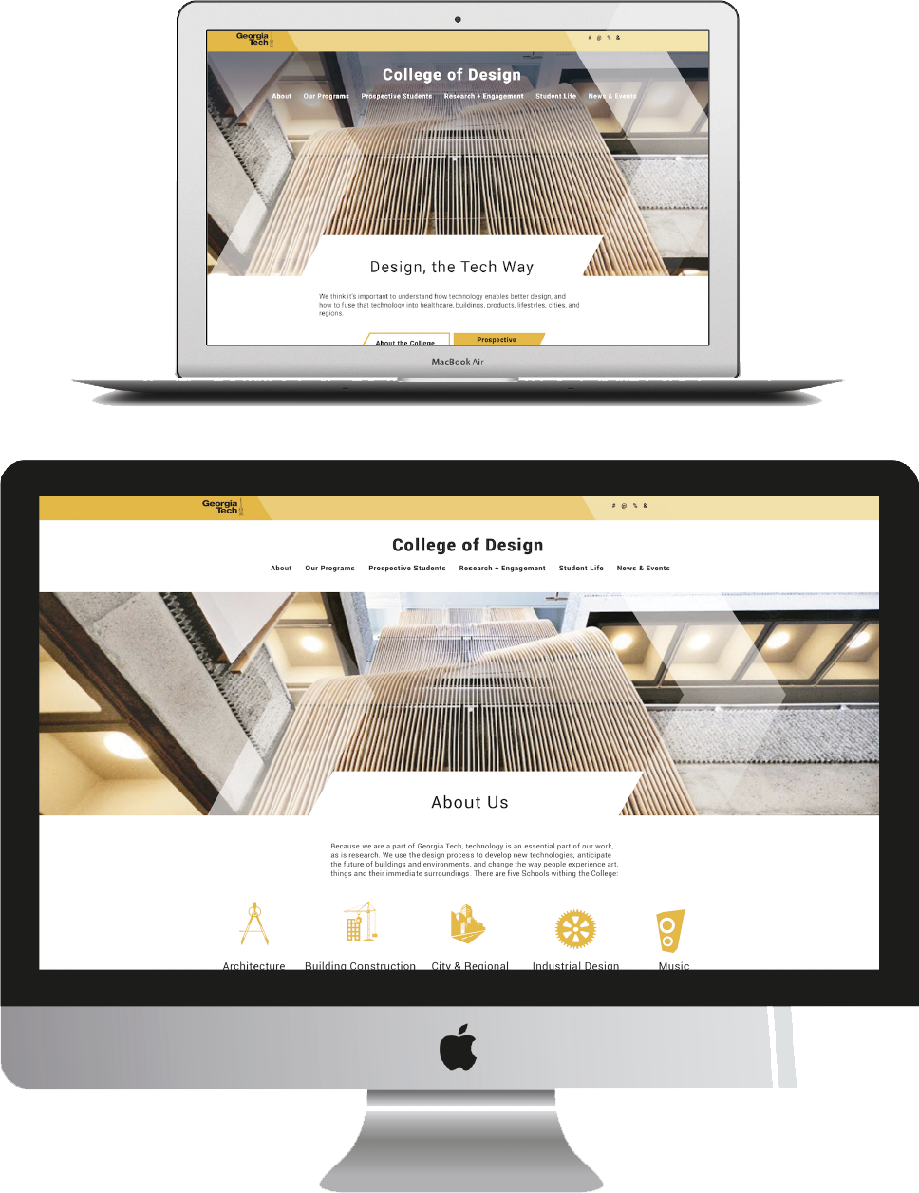

Slide 26
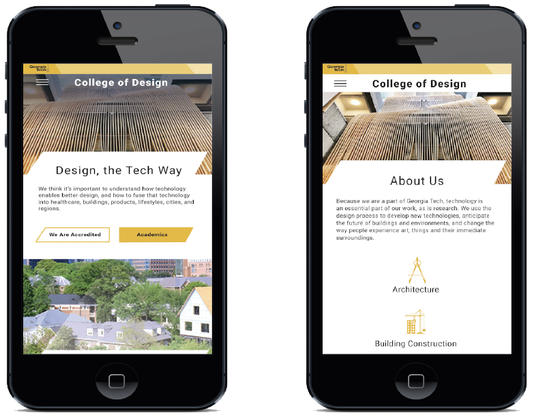


Slide 27

Design Tips
Update your photographic assets
Avoid stock or generic old pictures whenever possible
Big, targeted graphics make impacts
    Be careful on overall page weight, and stagger pages with smaller images
Design for your audiences
          Younger, recruitment, call to action = brighter
          Alumni, professionals = clean and somewhat muted
Embrace loading time & white space
    Content needs to breathe, and mobile users are finicky over libraries
Use accessibility guidelines
    From the start: 44 x 44 pixel targets, WCAG 2.0 AA color contrast ratios
Notes:
Bootcamp vs stripped down grid etc

Slide 28

Technobabble and Geekery
Make it do the thing Zhu Li

Slide 29
General Migration SEO
HTTPS – everywhere
    Google prioritizes https://support.google.com/webmasters/answer/6073543
Keep or redirect all URLs
          Catalog / export your aliases from CMS or Google Webmaster Tools
          DO NOT just redirect 301 old pages to home page
          Check XML sitemaps
Check mobile response with Google
    https://search.google.com/test/mobile-friendly
Use all the tools
          https://www.bing.com/toolbox/webmaster
          https://www.google.com/webmasters/tools/
          Link checker Xenu for Windows: http://home.snafu.de/tilman/xenulink.html
          Integrity for Mac: http://peacockmedia.software/mac/integrity/free.html
Notes:
Michael GAMBLE !!! ! !! ! !!

Slide 30
Drupal Migration SEO
Dump Existing Path Redirects
SELECT src,dst FROM url_alias INTO OUTFILE '/tmp/aliases.txt';
drush sql-query "SELECT source, alias, language FROM url_alias;" > aliases.txt
PathAuto
    https://www.drupal.org/project/pathauto
Google Analytics
    https://www.drupal.org/project/google_analytics
Metatag
    https://www.drupal.org/project/metatag
Redirect and Redirect 404
    https://www.drupal.org/project/redirect

Slide 31
Enhance UX
LQIP & Intrinsic images can speed apparent load times
          Low Quality Image Replacement and SVG outlines of images
          https://www.guypo.com/introducing-lqip-low-quality-image-placeholders/
          https://www.npmjs.com/package/image-trace-loader
          https://github.com/technopagan/sqip
          Intrinsic Ratios CSS: https://css-tricks.com/aspect-ratio-boxes/
Progressive Web App features get noticed
          Provide off-line and cached viewing
          Acts as first party application in Win10, Android, FF (soon)
          https://medium.com/samsung-internet-dev/6-myths-of-progressive-web-apps-81e28ca9d2b1

Slide 32
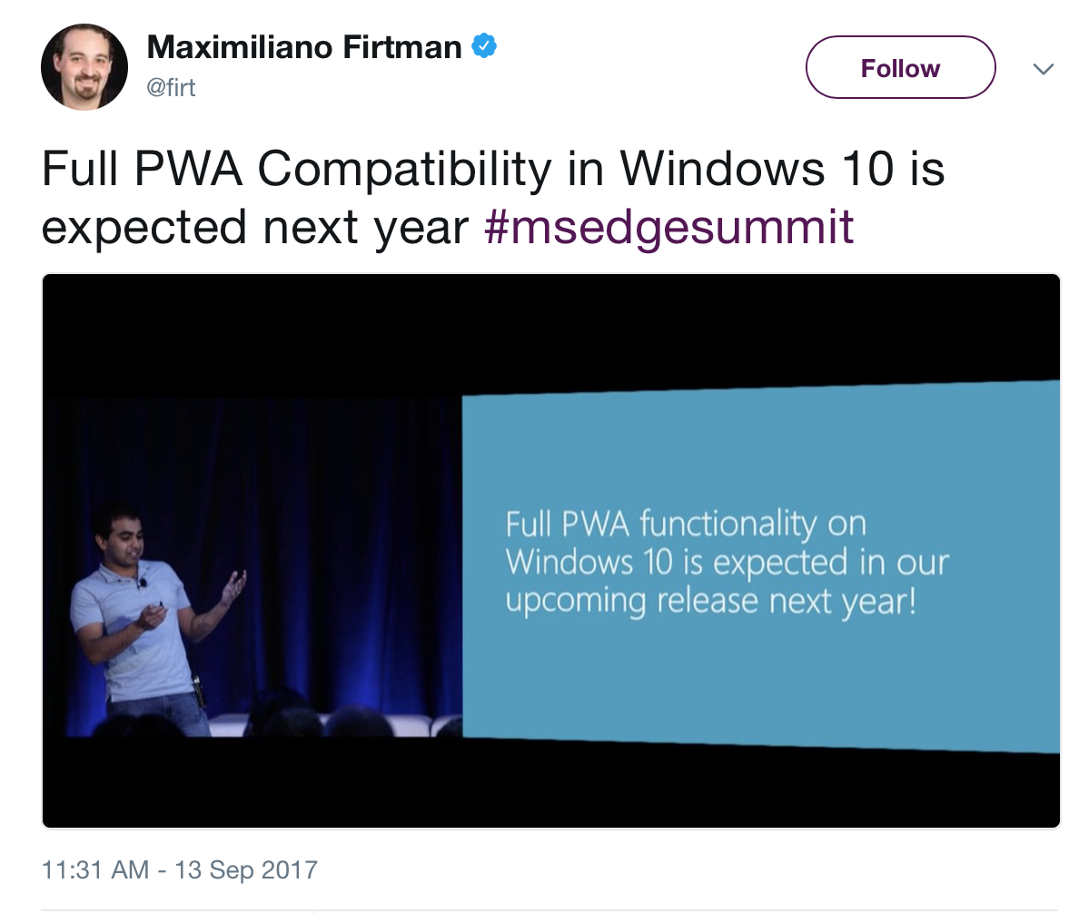
Enhance UX
Notes:
Much like doing your manifest and favicons for windows 8 /10 and xbox tiles, now you can have websites show up like native apps in Win10 with Edge

Slide 33

Thanks!
Any questions?
You can reach me at:
@konfuzed
michael.sheldon@design.gatech.edu

