Slide 1
Drupal DevOps Is Not Just For Experts
Will Hinton
Notes:
Some Drupal talks are very specific about how to do particular tasks or configure modules. This is not one of them.
My goal today is to potentially change your way of thinking about working with Drupal.

Slide 2
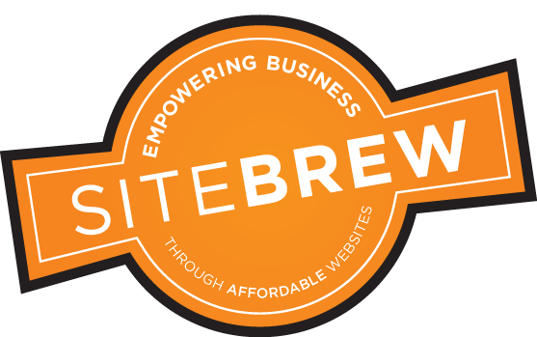
ABOUT ME
On Drupal.org for 13 years (Drupal 5,6,7,8)
Freelance Drupal developer for 3 years
Managed corporate websites for Manhattan Associates - 8 yrs
Launched one of the first corporate multilingual D8 sites
Business and technology consultant
Notes:
SEI –

Slide 3
“An expert is a man who has made all the mistakes which can be made, in a narrow field.” – Niels Bohr
Notes:
I have made ALL the mistakes.
I have hacked core
I have hacked contrib modules
I have deployed updates to live production sites during business hours and broken sites completely
I have deleted site dbs and had to have hosting support provide me with backups
I have actually made a list of rules for myself based upon mistakes I have made:
Don’t ever use GoDaddy
Don’t ever host on a Windows Server
Learning from mistakes is how we make progress and get better.
A key tenet of DevOps and Agile is moving away from a blame culture that focuses on mistakes and instead moves towards a constantly improving culture that accepts mistakes and learns from them quickly; FAIL QUICKLY

Slide 4
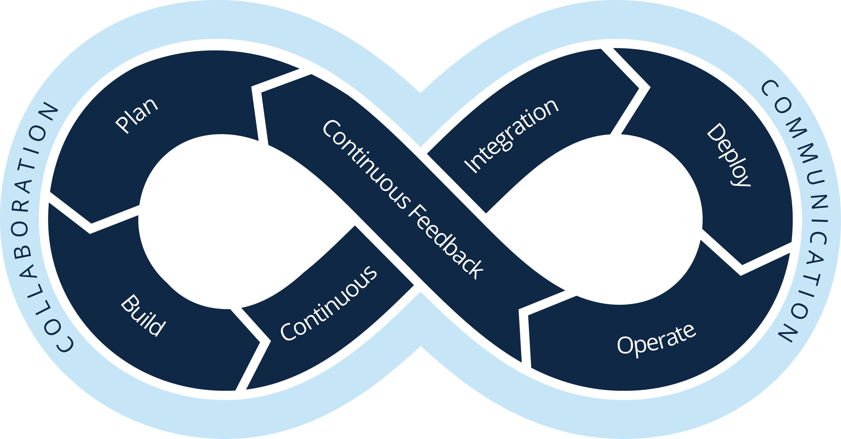
The Flow of Web Development
Requirements
Design/Architect
Build
Test
Deploy
Notes:
One of my first mistakes was seeing web development like this…
How many deployments?

Slide 5
What is DevOps?
“…it is not the most intellectual of the species that survives; it is not the strongest that survives; but the species that survives is the one that is able best to adapt and adjust to the changing environment in which it finds itself.”
Notes:
NOT Charles Darwin but Leon Megginson, business professor

Slide 6
What is DevOps?
”DevOps is the practice of operations and development engineers participating together in the entire service lifecycle, from design through the development process to production support.”
DevOps Values
DevOps Principles
DevOps Methods
DevOps Practices
DevOps Tools
Notes:
Not just automation
DevOps Methods – your way of implementing the values and principles. Could be XP, Scrum, etc.
DevOps Practices – specific tactical techniques (continuous integration, continuous deployment, configuration management, virtualization, etc)
DevOps Tools – Release tools (Jenkins, Travis), Configuration management (Puppet, Chef, Ansible), Virtualization/containerization (AWS, Vagrant, Docker)

Slide 7
DevOps: Perception vs Reality
Perception
Reality
Just for large development shops
The smaller your organization, the more you benefit
Takes too much time
Will save you time
Overly complicated
Will streamline your business
Just for experts
Even beginners can benefit
Notes:
A single freelancer business is the most obvious place for DevOps; one person must do everything

Slide 8
You Need A Plan
"Everybody has a plan until they get punched in the mouth.”
Drupalgedden
GDPR
New corporate brand
New hosting company

Slide 9
Common Scenarios
How do I quickly apply security updates?
How can I quickly deploy new features?
How can I quickly and reliably install, test, and deploy module updates?
How can I test new theme updates?
How can I add new developers to my team and get them up to speed quickly?
How can I migrate my site to a new hosting provider?

Slide 10
DevOps Practice Areas
Infrastructure
Automation
Create your systems, OS configs, and app deployments as code.
Site Reliability Engineering
Continuous Delivery
Operate your systems; monitoring and orchestration.
Build, test, deploy your apps in a fast and automated manner.
Notes:
Infrastructure as code (configuration management vs clickety clickety)
Automate deployments

Slide 11
Drupal DevOps Maturity Model
Level 5
Optimized
Level 4
Managed
Level 3
Defined
Continuous Integration
Continuous Deployment
Automated functionality tests
Visual regression tests
Modern hosting platform optimized for DevOps
Feature branch environments
Configuration Management
Level 2
Repeatable
Standardized local dev environment
Drupal install profile
Prod/Dev/Test environments
GIT workflow
Level 1
Initial
Composer
GIT repository
Local development environment
Automation scripts
Manual deployment
No version control
No automated processes
No DB/files backups
No testing
Maturing

Slide 12
Drupal DevOps Scenario – Module Security Patch
No DevOps
DevOps Practices and Tools
Download module and copy over old version
Push code to server via FTP or rsync
Run database update
Check available updates to confirm that module has been updated
Cross fingers
Start over because you forgot dependency on a different module
Repeat
Repeat
Repeat
Create new GIT feature branch
Update module with Composer
Create new GIT commit
Run build/deploy script
Create new site build
Run Behat tests
Deploy site build on multi-dev environment or local container
Pull production DB/files to Dev environment
Run DB update
Confirm
Push feature branch to remote repo to begin workflow
Run build/deploy scripts
Create new site build
Run Behat tests
Deploy site build on Dev environment
Pull production DB/files to Dev environment

Slide 13
Drupal DevOps Scenario – Module Security Patch
No DevOps
DevOps Practices and Tools
Too slow
Too easy to make mistakes
Not scalable
Not easily repeatable
Not transferable
Fast
Automated to decrease/eliminate mistakes
Scalable for multiple sites/developers
Repeatable
Transferable (platform/version/developer agnostic)
Notes:
Infrastructure as code – everything (code, CI/CI, configuration-driven)

Slide 14
Questions?
Will Hinton
whinton@sei.com

