Slide 1

Inclusive Digital Products:
Why Web Accessibility Matters
November 10, 2018

Slide 2
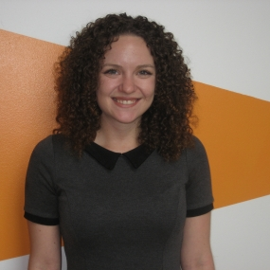

Hi, there!
Kara Gaulrapp
Front-end Developer at Message Agency
Accessibility Advocate
Notes:
Hi, everyone. I’m Kara Gaulrapp and I’m a front-end developer at MA, where I oversee our web accessibility initiatives.

Slide 3
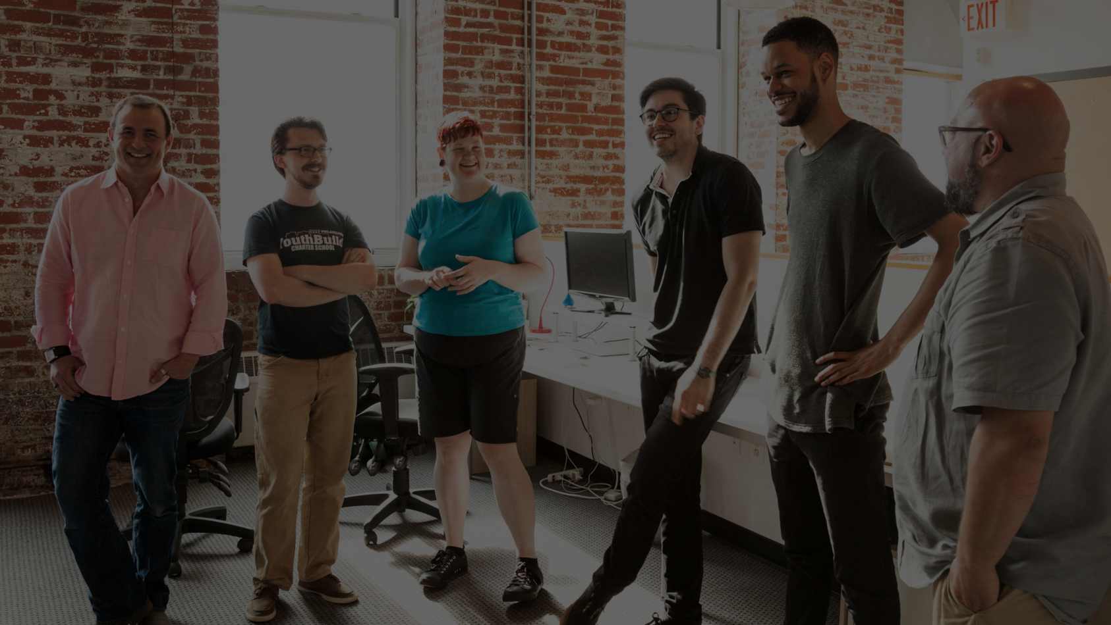


We build better brands and websites for the greater good.
Message Agency is a social enterprise that helps nonprofits use technology to enlighten, educate, engage, and enact change.
Notes:
Message Agency is a full-service digital agency in Philadelphia.
We’re a Certified B Corporation working with nonprofits, universities, foundations, government, and mission-aligned for-profits
Message Agency is a social enterprise that helps nonprofits use technology to enlighten, educate, engage, and enact change.

Slide 4
Hi, there!
Kara Gaulrapp
Front-end Developer at Message Agency
Accessibility Advocate
Notes:
For the last ten years, I’ve worked primarily in the education technology space. In the past, I’ve developed digital literacy curriculum for students with learning disabilities and designed a learning platform that focused on adult literacy and English Language Learning.
With a personal mission to create an inclusive web, I’m an accessibility advocate and I’m here today to help YOU guys fight this good fight.

Slide 5
Outline
What is web accessibility?
Why should I care?
Where do I start?
How do I get people to care?
Question and Answer
Notes:
I’d like to give you guys a little bit of an outline of today’s session. It’s broken up into questions, that by the end of this presentation we’ll all have the answers to!
We’ll start by going over what exactly is web accessibility, where it started, who governs it, and other background information to level-set ourselves.
Next, we’ll be going into why we should care about web accessibility, both in a humanitarian and business sense.
Then, we’ll talk about what you can start doing right now, or on Monday rather, to make your projects more accessible. We’ll go over different tools and strategies that you can implement at every stage of your project.
And before we get into our Q&A portion, we’ll talk about what tactics you can use to start or continue making web accessibility a priority in your projects.

Slide 6
What is Web Accessibility?
Notes:
In our physical world, we understand why we need to have things like ramps to buildings and at sidewalk crossings. We understand why signs have braille and why doors have push plates.
It’s to provide access to areas, information, and functionality that any given person may need.
Web accessibility is an extension of those considerations. It’s a set of best practices and guidelines that reduces or removes the barrier to entry. It’s used to ensure that all users have equal access to information and functionality.
So where did these standards come from?

Slide 7
The power of the Web is in its universality.
Access by everyone regardless of disability is an essential aspect.
Tim Berners-Lee, inventor of the World Wide Web
Notes:
They come from the World Wide Web Consortium, or W3C. Which is lead by inventor of the internet, Tim Berners- Lee
And he has this great quote.
The W3C, for those who don’t know, is an international organization that sets protocols and guidelines for ensuring the long-term growth of the web.
Inside the W3C is The Web Accessibility Initiative, which published the Web Content Accessibility Guidelines 1.0, or WCAG for short, in 1999. In 2008, Web Accessibility Initiative published 2.0 and recently published 2.1 which is now considered the standard.
So, these guidelines have been around for 20 years! That’s a long time. But what are they?

Slide 8
WCAG Principles
Perceivable
Operable
Understandable
Robust
Notes:
WCAG divides its guidelines into four principles.
Perceivable
Information and user interface components must be presentable to users in ways they can perceive.
It can’t be invisible to all of their senses
Where we have alt text and text equivalent of information
Closed captioning
Perceivable also means that it’s able to support assistive technology, such as a screen reader.
Removes reliance on shape, location, color or sound to navigate (see the highlighted text at the bottom of this page)
Operable
This means that users must be able to operate the interface and that the interface cannot require interaction that a user cannot perform
You can use the website and perform all of its functionality with a keyboard
No action timeouts, such as forms that require you to fill it out in 5 minutes. People with cognitive disabilities might need more time to process not only what’s being asked of them but how to appropriately and correctly respond to what’s being asked of them
Alternative ways of finding information, like a table of contents or sitemap
Understandable
This means that users must be able to understand the information as well as the operation of the user interface (the content or operation cannot be beyond their understanding)
Glossary for unusual terms
Reading level
Clear definition of input requirements and error messaging
Robust
Content must be robust enough that it can be interpreted reliably by a wide variety of user agents, including assistive technologies.
This also means that users must be able to access the content as technologies advance
Content should be well-formed so it can be parsed successfully by browsers and other user agents such as screen-readers.
The name and role of user interface components (e.g. form inputs, buttons, links, etc.) should be programmatically determinable.

Slide 9
Why Should I Care?
Notes:
So, why should I care?
We all know it’s the right thing to do. We as project managers, designers, and developers are gatekeepers, and it’s our responsibility to not gate people off and to make sure that every aspect on a web project can be accessed by anybody, regardless of limitation.
In our physical world, if a blind person came up to you and asked a question, you wouldn’t say “Sorry there’s no room in the budget for me to share that with you. Maybe in Phase 2.” so why would we block these users from accessing content or functionality in our digital world?
When we don’t plan for creating accessible products and integrate ways for our sites to be used by all, we’re undervaluing people based on things that are out of their control. We don’t have the right to do that and there’s too much of that in the world today.

Slide 10
Business Cases
Social
Technical
Financial
Legal
Notes:
But doing the right thing can’t always convince people. Luckily, There’s plenty of business cases you can make for implementing an accessible product.

Slide 11
Social
Solve for one, extend to all
Digital divide
First-time internet users
Low literacy and fluency
Notes:
First on our list is the idea that when you solve for one, you’re enhancing the experience for all.
For instance, you may not have a vision limitation, but if the text on a website has proper color contrast that benefits users with a color blindness, on a sunny day looking at your phone and the sun is glaring on it, you’ll be able to see that text better. On the same token, Having a healthy amount of line-spacing, a san-serif font, and a larger font size on our body copy not only helps people with dyslexia, it helps older folks not have to zoom in so much
Next, is the digital divide. Did you know that 10% of Americans lack high-speed internet, and this number particularly affects low-income people. When we conflate our sites with insane animations and upload 3 megabyte images into the WYSIWYG (I’m looking at you content editors), we’re creating a barrier to entry. Things like compression benefit everyone. And this is becoming particularly more important when we think of things like Net Neutrality.
In the coming years, we’re going to see a lot of first-time internet users

Slide 12
First-time Internet Users by 2020
1.1 billion worldwide
23 million in America
Notes:
For my numbers people, I got some stats for ya.
That’s a WHOLE lot of people. I’ve been on the Internet since I was five and I make websites for a living, so suffice to say I can navigate my way through some atrocious information architecture or pick up on User Interface patterns fairly quickly.
But for those who aren’t as tech-savvy, we want to make sure that the patterns we’re using are intuitive and the instructions we’re giving for things like filling out forms are clear and apparent. If our functionality differentiates from common practices, we need to make sure that we offer information that can guide users. We also want to make sure that we offer a way to undo or back out of tasks, so users don’t get stuck in a place where they don’t know what to do.

Slide 13
Social
Solve for one, extend to all
Digital divide
First-time internet users
Low literacy and fluency
Notes:
We also can’t anticipate the reading levels and fluency of our users. The WCAG says you should write your content to a 6th grade reading level. Things like chunking information, and writing in clear, concise language helps this population digest your information. Even using icons can help aid in this area. If your content uses words or terms that the average person may not know, consider putting a glossary on your site.

Slide 14
Technical
Reduce site development and maintenance time
Reduce bandwidth use and server load
Device independence
Forward migration and backwards-compatibility
Notes:
From a technical standpoint, we’re reducing development and maintenance times. Since we’re building web sites against best practices, our clean code means less support tickets about Internet Explorer and solving for one-off devices. It also makes doing a site redesign much easier..
Let’s talk compression. When we pay close attention to how large our websites are, and make an active effort to reduce its size, we don’t need to worry as much about load times and how many times our server is being asked to transfer data.
There’s thousands of devices out there, and we can’t anticipate them all. When we use correct semantic markup, it helps users who are using older technologies still be able to use our products and ensures that our products will continue to work on the latest and greatest. We want to make sure our digital products function the same on a low-cost device as it does on an iPhone X.
The average lifespan of a website can be 3-5 years. At MA, we strive for 7-10. If you’ve ever had to migrate content from an old system, you know what a headache that can be. By keeping our code and structure clean, we can make that process easier.

Slide 15
Financial
Increase website use
Search engine optimization (SEO)
Direct cost savings on website
Decreases legal threat
Notes:
By making our websites accessible, we’re increasing our market segments. 15% of the world has some form of disability, and if we add that to the number of first-time internet users, that’s a whole lot of people we’re ignoring.
Google also likes us better when we have well-structured content. When the GoogleBot can tell exactly what our pages about, we rank higher. Using the correct semantic markup, Grade 6 reading level, and alt text on our images helps us do that too.
For direct cost savings, all the things we talked about on our technical slide apply here. From server load, maintenance, and even the cost of translating content or redesigning a site is minimized.
We’re also decreasing our legal threat, potentially the biggest money saver of them all.

Slide 16
Legal
Americans with Disabilities Act (ADA)
Supplemental Advanced Notice of Proposed Rulemaking (SANPRM)
Who’s covered?
Notes:
The Americans with Disabilities Act (ADA), signed into law in 1990, prevents discrimination against a group that has historically faced many barriers. The ADA makes it illegal in this country for any government or business to provide goods and services to the public that are not also accessible to people who have disabilities.
In many situations, however, it can be challenging to establish just what is meant by accessible. That’s why the U.S. Department of Justice (DOJ), which enforces the ADA, has issued a Supplemental Advanced Notice of Proposed Rulemaking (SANPRM) to incorporate web accessibility into the standards. Organizations are encouraged to use the WCAG 2.0 level AA technical requirements as a guide for digital accessibility.
A wide range of agencies and companies are covered under the ADA. This includes state and local governments (Title II regulations), and what are termed “public accommodations” (Title III regulations) – which are, essentially, any business or non-profit organization that serves the public. Title III covers a lot of ground, including restaurants, theaters and schools, ensuring that individuals cannot be denied entry to these places, or denied service by these companies, solely based on a disability. This includes services that are provided through a website or other digital format.

Slide 17
Where do I start?
Notes:
So this is a lot of information to take in, and it might seem a little daunting to start.
But here are some ways that you can start incorporating web accessibility into every stage of your product.

Slide 18
Planning
Build in, not bolt on.
Accessibility as a requirement
Plan for training
Notes:
Who here is either a project manager or responsible to putting together scopes and budgets?
When you’re first planning out your project, be clear that accessibility is a requirement, and is launch critical. It’s imperative to build accessibility in, not bolt it on. When we wait until QA to care about web accessibility, development slows down, we go over budget, and the design might even need to change. It then seems like accessibility is the thing that’s holding us up and is the problem, but in reality it’s a process problem.
Map out exactly what conformance level you’re planning to achieve and use the WCAG’s checklist to help write the requirements or testing scripts based off of them. Be proactive and share these requirements across teams, so everyone’s on the same page and there’s time to answer any questions or address any implementation challenges. This will also help you plan what you’re missing. As an example, if you have a lot of videos on your site that contain important information, you’ll need to provide the text-equivalent of that, either through captioning or transcripts.
You may also find yourself in a position where you have to train content creators on making their content more accessible. Starting these conversations early will keep your machine well-oiled.

Slide 19
Discovery and Design
Universal and Inclusive Design
Personas with limitation
Vet mockups
Test, test, test!
Notes:
Who in here is either a design, UX person, or information architect?
When thinking of accessibility in discovery and design, there’s a few things we can do to ensure that our designs and experiences are being inclusive to all users.
Designing for accessibility comes with it’s challenges, for sure. But good design and good designers tackle those challenges. And having an accessible website doesn’t mean you have an ugly website.
The first is to adopt either the Universal Design or Inclusive Design principles. They’re both human-centric and empathetic approaches to design that put people first.
Your designs will be stronger and more intuitive because of it. With accessibility, we consider vision, hearing, cognitive, and mobility limitations. Human-centric design encompasses accessibility and takes things like location, gender, language, education, and age into consideration as well
It’s the idea that whether out of circumstance, choice, or context people are diverse. As people use different approaches and tools to read and operate interfaces, what the interface offers each user should be comparable in value, quality, and efficiency.
For those familiar with personas, we can create personas with limitations. Personas are putting names, faces, and attributes to who your users are. So if we create a few that have a disability, whether permanent (like blindness) or temporary (like a broken hand), we’re making sure our web site’s experience can be extended to as many people as possible.
We’ll also want to vet mockups and wireframes. Check for things like color contrast, and make sure that all form elements have labels.
Interesting fact I learned recently about color vision deficiency: a lot of time when we think of color contrast, we think of people with color blindness, but a study recently came out of the University of Freiburg that patients who are depressed, both on medication and not, have reduced contrast sensitivity, meaning the difference between blank and white isn’t as strong as it is in patients who weren’t depressed.
We also need to vet mock ups. You can have a carousel, but we shouldn’t autoplay it and we should put a pause button on it. You can have a mega menu, but put a Skip Navigation link in. And also make sure it’s keyboard accessible. Many navigation bars leave keyboard users unable to access the dropdown menus. (DrupalCamp ATL, I’m looking at you.)
'Infinite scrolling' can be problematic, especially for users navigating by keyboard because they can't get past the stream of refreshing content or someone using a screen reader. Give the option to turn off this feature and replace it with a 'load more' button. Same with animations and parallax effects.
Know in advance that users are going to make mistakes and not use our tools the way we think they will. So we need to test our products with all types of people. There’s No use designing for empathy if you’re not going to be looking for input and feedback from actual users that have these limitations

Slide 20
Development
Web extensions and command-line tools
  WAVE, DevTools, SiteImprove, pa11y
2. Semantic markup and WAI-ARIA
3. Responsive and compressed images
4. Use assistive technology
Notes:
Who are my developers in here?
While we’re in development, we’ll want to be actively checking the status of our accessibility. Using tools like the WAVE extension, Google’s DevTools to run accessibility audits, or a command line tool like pa11y can give you insight into how you can increase your compliance. I’m also a fan of the SiteImprove extension, since it groups alerts and errors by responsibility - like content editor or developer.
And when we create our accessible websites, we’re using correct and meaningful semantic markup. This helps users who are using older technologies still be able to use our products and ensures that our products will continue to work on the latest and greatest.
We can add WAI-ARIA roles where necessary. This stands for Web Accessibility Initiative – Accessible Rich Internet Application. It allows us to add role, property, and state information to dynamic web applications. I’ve recently started playing around with ARIA Live regions since we use AJAX for a lot of our searches and filtering. What the ARIA Live region does is alert someone who is using a screen reader that there’s a change in content or context.
We can also artificially limit ourselves and use assistive technology during development to make sure that the changes we make are increasing the accessibility of our project. Whether it’s tabbing through a website or using my computer built in VoiceOver app, I may be able to pick up on things that I normally wouldn’t have.
Image links
Also for those of you who don’t know, if you’re an Apple user, your phones and computers come with a set of accessibility tools, like a built-in screen reader.

Slide 21
Content
Use CKEditor’s Accessibility Checker
Be mindful of image size (and alt text)
Check your content’s reading level
Write meaningful links
Notes:
For those of you who control a site’s content, you have a very important role!
Working in an agency that manages many different sites, I’m not running accessibility test on your site everyday, but you might add content to your site everyday.
I highly recommend using CKEditor’s Accessibility Checker. If you do not have this installed on your site, ask your developers to enable this plugin.

Slide 22
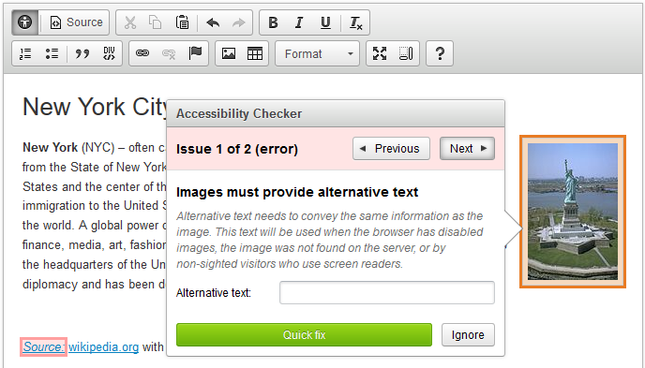
Notes:
Simply clicking this button will not just highlight accessibility issues, but it will often times automatically correct it.
It also gives you a reason why it’s an error.
For example, skipping a heading level, h1, h2, h3, is a violation. A lot of times, people skip heading levels because they like the way an h3 tag looks more than an h2. I consider this plugin a “reinforcement layer” because it explains why something is wrong. People also don’t like alerts yelling at them, so I also think it trains them a bit :)

Slide 23
Content
Use CKEditor’s Accessibility Checker
Be mindful of image size (and alt text)
Check your content’s reading level
Write meaningful links
Notes:
Check your content’s reading level -- I highly recommend the website hemingwayapp.com

Slide 24
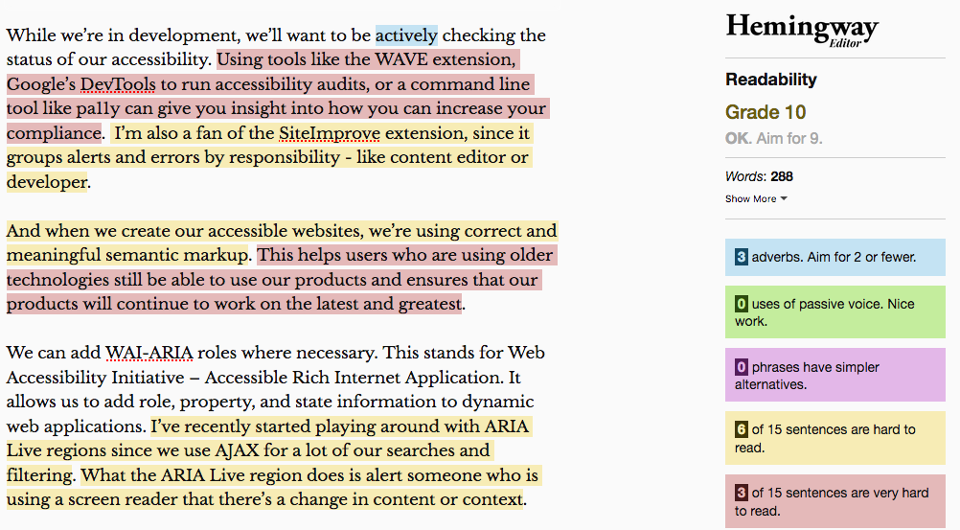
Notes:
This is what my script for this presentation looks like. This app is great because it highlights areas of improvement!
I will say, they could use some icons in here because as we learned, we shouldn’t use color alone to indicate the state of something!

Slide 25
Content
Use CKEditor’s Accessibility Checker
Be mindful of image size (and alt text)
Check your content’s reading level
Write meaningful links
Notes:
And please, write meaningful links. Link text like “read more” or “learn more” mean nothing out of context. If you’re listening on a screen reader, it can be confusing to users, and they’ll ask themselves “Learn more about what?”
Accessibility checkers, like WAVE, will flag this as “redundant links”

Slide 26
Retrofitting, Audits, Maintenance
DIY vs working with a vendor
Continuous audits
Communication
Notes:
Now these strategies are great if you’re in the position to be rebuilding or doing considerable development. But if you’re in the position where you have to retrofit a website or make interim repairs before a site redesign, there are still things that you can do to help.
The first is identifying if this is something you can do in house or need to contract a vendor for. If you don’t have the in house capacity to deploy these changes, consider a vendor. You’ll want to make sure this company has a solid track record working with clients in your industry and working with the technology that you’re currently employing
If you’re going down the DIY route, make sure you have set clear expectation and milestones, along with a timeline for how you can implement these changes.
Accessibility audits are a great way to identify where your site is lacking in accessible functionality.

Slide 27
What an Audit is
A checklist
A reference point
A roadmap
Notes:
An a quick word about audits
An accessibility audit is:
A checklist of whether or not a site meets its organization’s compliance success criterion
A reference point of where a site at a specific point in time stands in compliance
A roadmap for future enhancements to better serve users with limitations,

Slide 28
What an Audit isn’t
The official stamp of a great experience
Scary!
Notes:
An accessibility audit is not:
The end all, be all factor on whether or not a site is truly a great experience to an end user with a disability.
While a site may pass all success criterion, it is highly encouraged to use actual assistive technologies and survey actual users to see how you can make improvements or enhancements.
All the tools out there, whether they’re automated or manual, can only tell you so much.
For instance, they can tell you that an image has alt text, but it can’t tell you if it’s meaningful in context
A successful audit is done by an actual human, with the help of these tools.
Now, audit is a scary word, but I promise you it isn’t.
you should think of it as your roadmap for how you can prioritize and execute needed changes.
The W3C has a phenomenal Website Accessibility Evaluation Report Generator that walks you through step by step how to perform your own audit.
https://www.w3.org/WAI/eval/report-tool/#/
We’ll also want to perform these audits multiple times at different times. I recommend doing a full-site audit once every 6-12 months, and mini-audits of your most frequently used pages and tools every 1-3 months.
Along with,
If any development change is deployed to one of these pages, a quick audit of the affected pages should be run.
And if a design change is implemented, it should be validated against a color contrast checker and/or a web-based accessibility tool.

Slide 29
Retrofitting, Audits, Maintenance
DIY vs working with a vendor
Continuous audits
Communication
Notes:
And lastly, Communication
We can’t anticipate how all users are going to be using our site. So having a page on your website that’s easily findable that maps out your commitment to web accessibility, the timeframes that you’re working against, and offering a clear way for someone to contact you about their frustrations.

Slide 30
How do I get people to care?
Notes:
Now hopefully I’ve gotten you guys to care, but how do we get others to? In a perfect world, “doing the right thing” is reason enough, but that’s not the world we live in.

Slide 31
Getting Buy In
Cite cases
Ask questions
Share responsibility
Notes:
Use the logical business cases that we talked about and statistics around website usage to help drive your point home
Keep talking and asking questions
* Be a constant reminder that we’re here to serve ALL users. Don’t be afraid to ask your designer why it takes a mouse-user one click to get to an important area of a site, and why it takes a keyboard user ten tabs to get to the same place.
* It’s best to get people across every team to be a part of this initiative. It’s not solely the developer, designer, or project manager’s responsibility to make sure we’re meeting compliance. It’s all of our responsibility.

Slide 32
Question Time!
messageagency.com
kara@messageagency.com

Slide 33
Resources
For Planners:
508 Standards Refresh Toolkit - bit.ly/508toolkit
508 Standards Roadmap - bit.ly/508roadmap
Accessibility Audit Guides - bit.ly/wa-audit
Adobe Accessibility Blog - bit.ly/access-blog
Hemingway App, Readability Checker - bit.ly/hem-app

Slide 34
Resources
For Developers:
Accessibility Developer Tools (Google) - bit.ly/adt-google
WAVE Chrome & Firefox Extensions - bit.ly/wave-ext
The W3C Markup Validation Service - bit.ly/w3validate
Web Design References/How to Articles - bit.ly/access-howto
NV Access Screen Reader - bit.ly/nv-access

Slide 35
Resources
For Designers:
WCAG Contrast Checker - bit.ly/cc-checker
10 principles of inclusive web design - bit.ly/idx-principles
U.S. Web Design System - bit.ly/us-design

