Slide 1
Flexible Microsites
Combining the Power of the D8 Group and Paragraphs Modules
Drupal Camp ATL 2019

Slide 2
Scot Self
Senior Development Engineer
Yes, Scot with one ‘t’
Live and work remotely from Birmingham, AL
Married ~19 yr to Daphne, 2 kids (Juniper - 11, Tristan - 9, homeschooled)
BA from Alabama, MA from NYU (in French!)
Amateur musician, huge fan of Phish and bluegrass
@scotself on Twitter, IRC and drupal.org
~10 yrs with Drupal, front-end, site-building
Semi-frequent module contributor

Slide 3
Notes:
WE’RE HIRING!!

Slide 4
Our Clients

Slide 5
Agenda
What is a “microsite”?
Group module basic concepts
Demo!
Review
Expected Issues
Links/resources

Slide 6
What is a “Microsite”?
Overused buzzword or actual useful concept?
What does a microsite need?

Slide 7
Group D8
A page or set of pages dedicated to a specific subject
May or may not be siloed off from the rest of a main site
If multiple pages, often has primary or secondary navigation to browse additional pages within that context
USGS Example
“Microsite”
Notes:
Each Mission Area of the USGS site could be called a “microsite”, with its sidenav keeping the visitor within the context of the MA they’re browsing until they decide to browse outside using top nav.

Slide 8
Group D8
Can join, be added to (or be invited to*) a group
Access to a group and its content based on Group type roles and permissions (along with Drupal’s)
* https://www.drupal.org/project/group/issues/2752603
Membership

Slide 9
Group D8
Need to be able to manage group “ownership” of various entities - nodes, media, menus, etc.
Each group’s content may or may not need to be siloed off from other groups
Ownership

Slide 10
Group D8
Modules providing essential group content plugins/functionality
Group menu
Group media
Group taxonomy
Menu link
Honorable Mention
Group domain - custom URL pointed to a Group
Block Visibility Group - combine multiple, advanced conditions for block visibility
Critical and extended
helper modules

Slide 11
Group D8
Flexibility (least to most?)
Fields - top to bottom display
Layout Builder - entity templates w/individual fields
Layout Builder - custom block types (w/Paragraphs!)
Paragraphs everywhere
Nesting is powerful!
Theming paragraphs is powerful (esp. nested, column-specific)
Sections w/columns
Column sizing, allowed paragraph types
(or a combination of all!)
Content Templating
and/or Customization
Notes:
Different ways of assembling the group home page and its content.
Templating of a group microsite will often (almost always) include navigation specific to the microsite.
Customizing the group and any additional content itself can be done in multiple ways. We’re going to talk about 2 which use the layout builder and one with just paragraph fields, but you can easily combine all 3 to build your pages for maximum flexibility.

Slide 12
Group Module
Basic Concepts
How Group Module covers Microsite building requirements

Slide 13
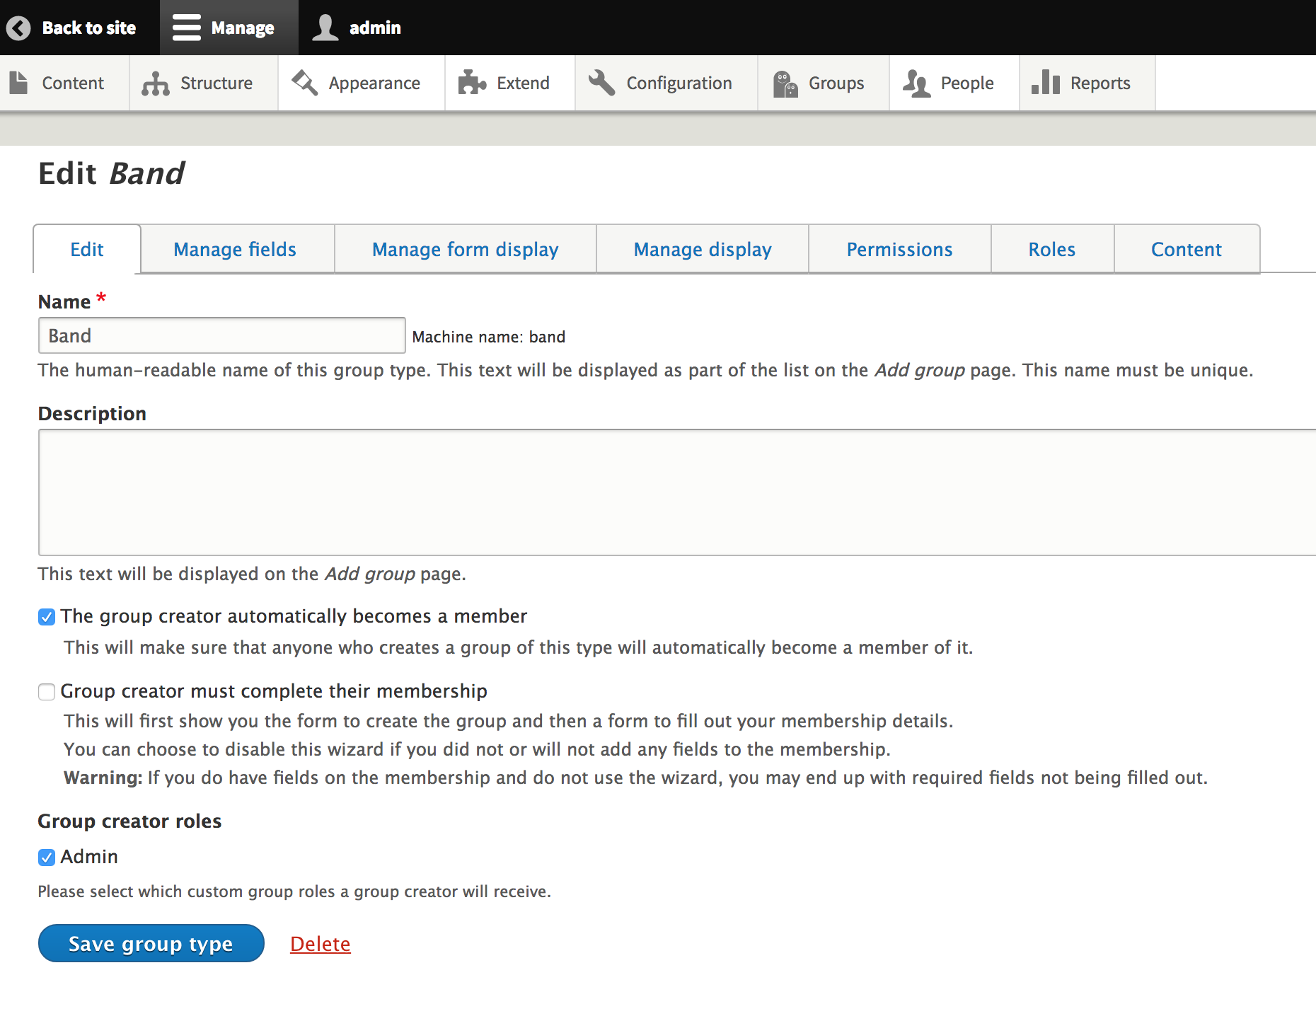
Group Module
Group entity
Group content entities - relate entities to the Group
e.g. Group membership entity - relates users to the Group, fields can describe user’s relationship to the Group, membership details, etc.
Roles/permissions per group type

Slide 14
Nodes (article)
Nodes (basic page)
Menu
Group node (article) (“group content”)
Group node (basic page) (“group content”)
Group menu (“group content”)
Group
Group membership (“group content”)
Credit: Mike Anello (@ultimike)
Users

Slide 15
DEMO TIME!

Slide 16
Basic Config
Setting up Groups and Group Content

Slide 17
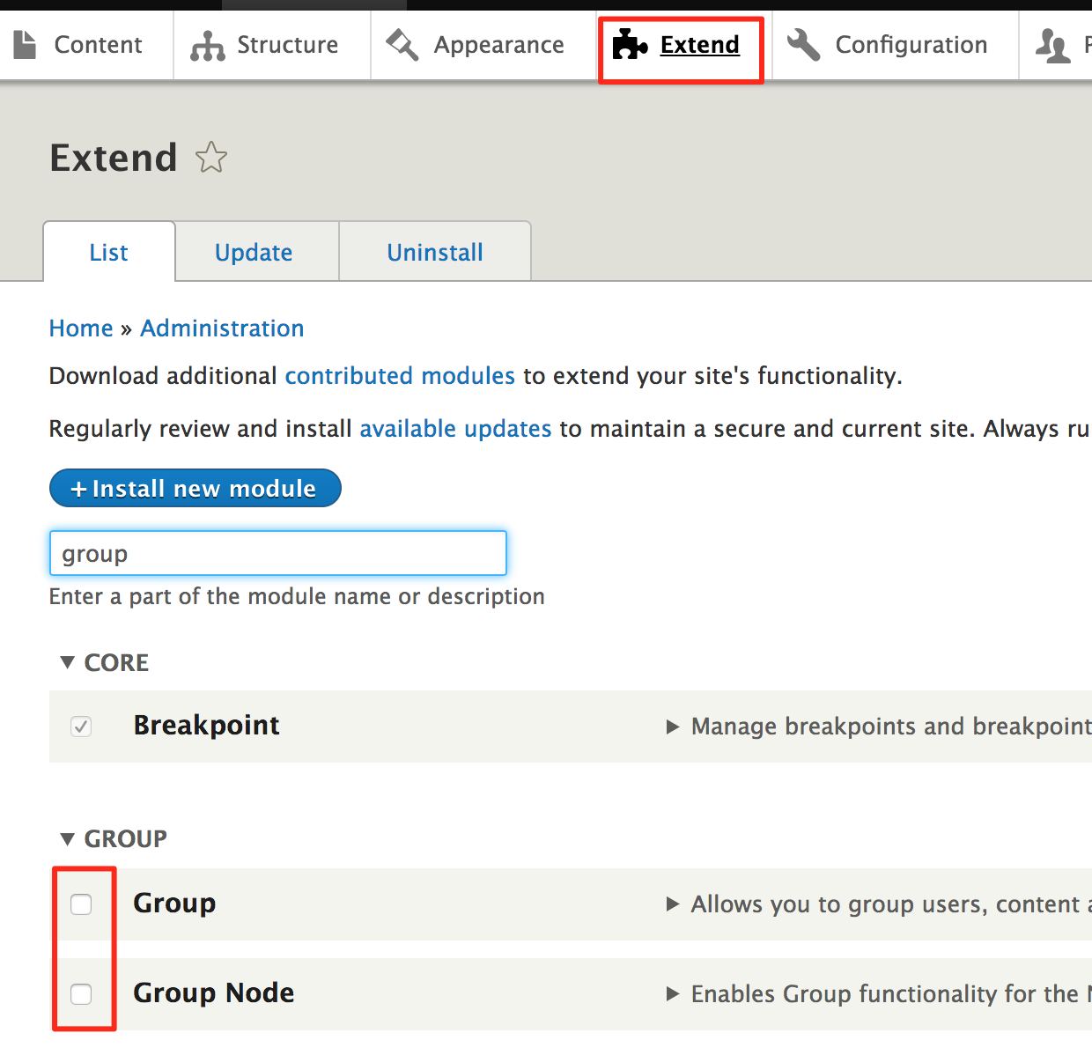
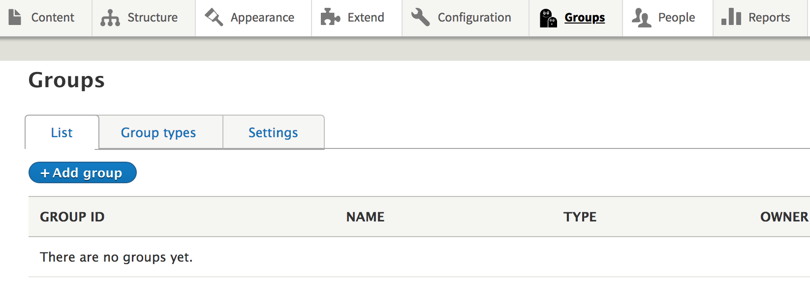
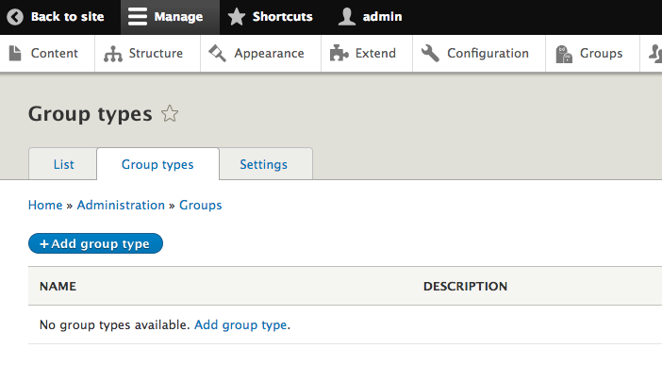
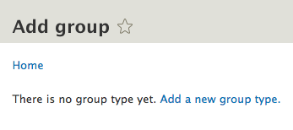

Slide 18
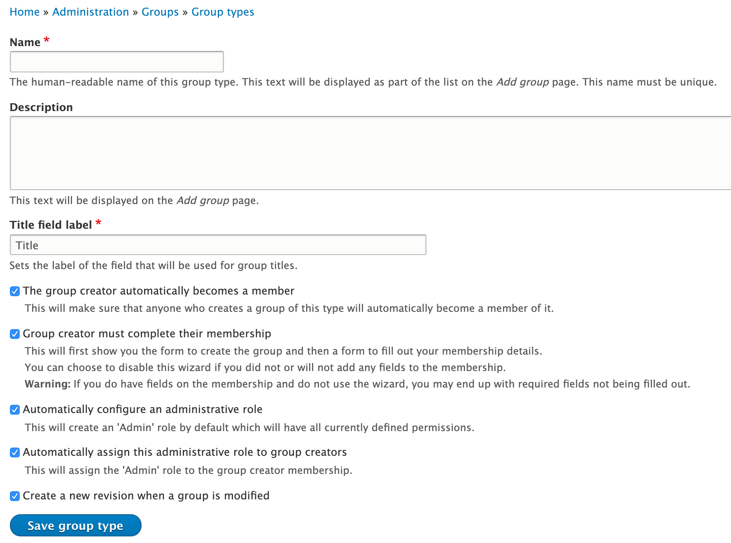
Group creator membership
Creator must complete membership (2-step wizard)
Automatically configure admin role
Automatically assign admin role to creator
Submit button text on new Group form affected by combination of the above
Create revision
Uncheck if membership has no fields

Slide 19
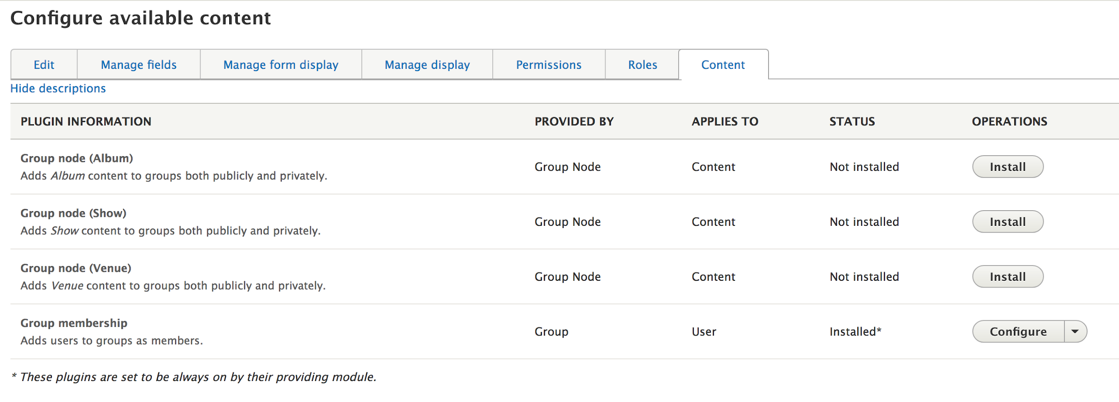
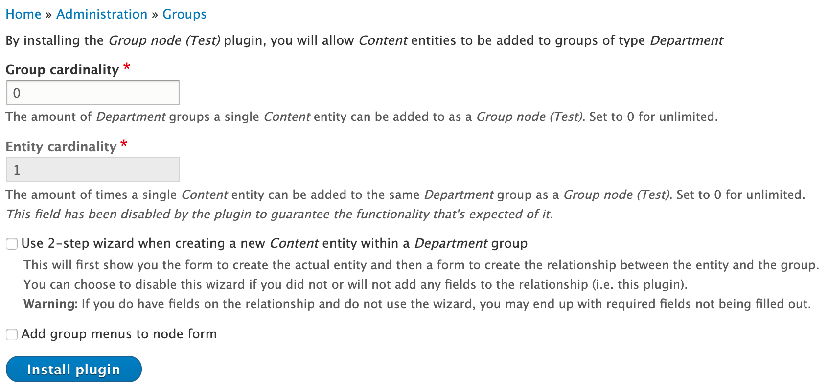
“Install” a plugin = Create a new, fieldable relationship entity type, make that entity bundle available as “group content”
2-step wizard
Create the relationship entity after creating the related entity
If no fields on the relationship entity, uncheck 2-step wizard
Redirects to either relationship entity or related entity, depending
Group membership plugin cannot be removed but is fully fieldable for adding additional info to users’ membership
Group menu plugin can be configured to add menu to Group on Group creation and add default link with customizable title

Slide 20
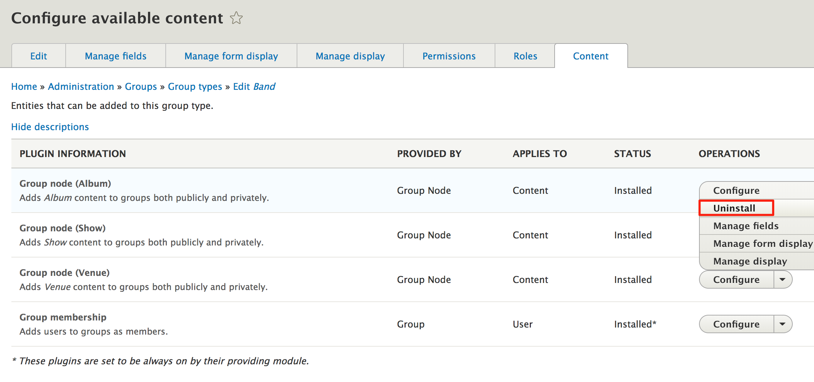
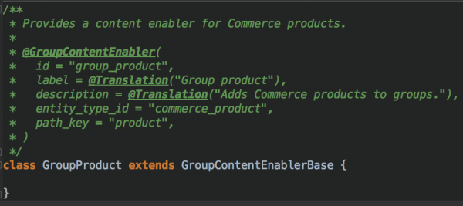
Each group content entity type is fieldable, describing the entity’s relationship to the Group.
An entity related to a Group can be viewed through the group content entity BUT not all entities of a particular type are necessarily related to a Group.
Uninstalling a plugin
=
Delete relationship entity
Related entities remain intact if relationship entity is removed.
Example of extending the GroupContentEnablerBase class to allow Commerce Product types to be Group Content

Slide 21
Create additional (Group type-specific) roles as needed, tweak permissions:
Allow all to view group - how else can they find/join the Group?
Don’t allow admin to leave Group?
Add, Edit/Delete any/own for each Group Content bundle and related entity
View (and View unpublished if using this patch) for each Group Content bundle and related entity
NOTE: Permissions not added automatically to admin role for enabled Group content bundles

Slide 22
Related entities tab = ALL entities related to the Group - nodes, media, menus, users
Add existing entity
Create group content for existing entities (users, content, media, etc) if plugin for that content type has been installed
Allows for “sharing” of nodes between groups while still having the ability to customize the relationship metadata (group content entity is fieldable)
If no CTs have been installed as Group content, takes directly to the “Add member” form
Add new entity
Create a new related entity (node, menu, etc.) and a Group Content entity in 1 step (or 2 for CTs which have a relationship entity defined and 2-step enabled)
Cannot add members from here
Separate tabs for some entity types with group content entities (members, content, menus, media, etc.)

Slide 23
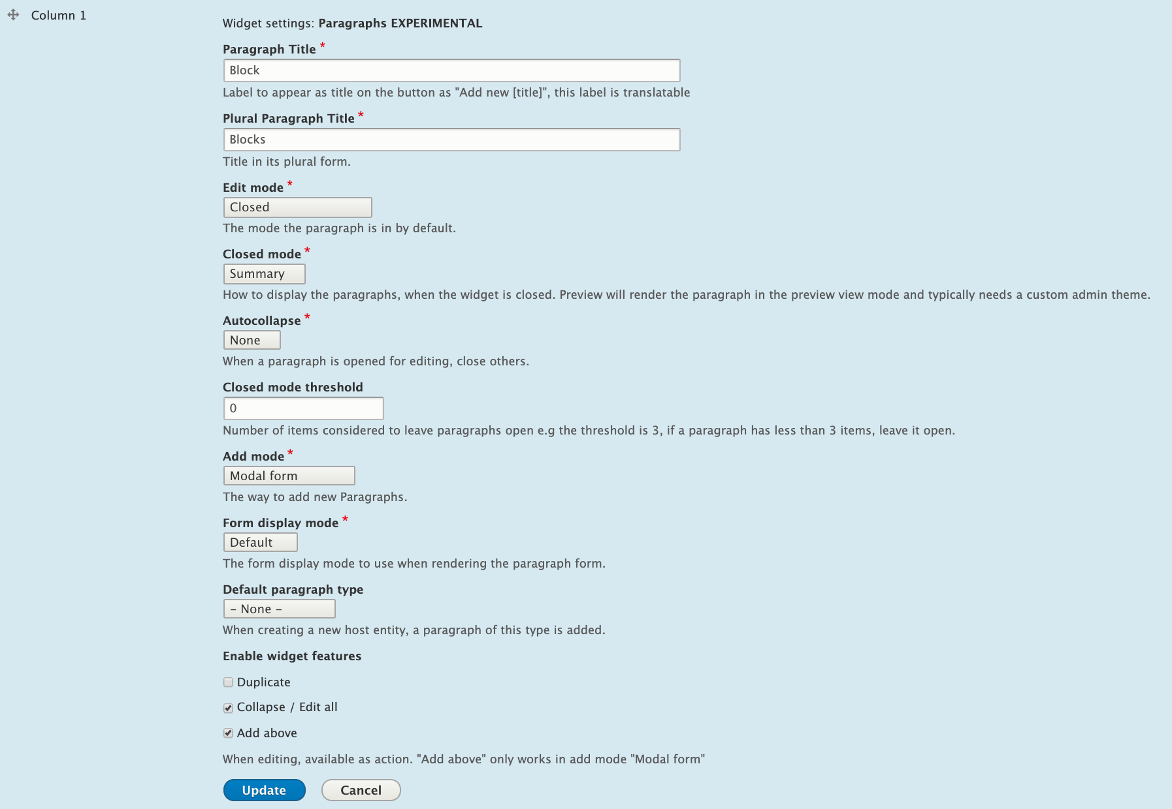
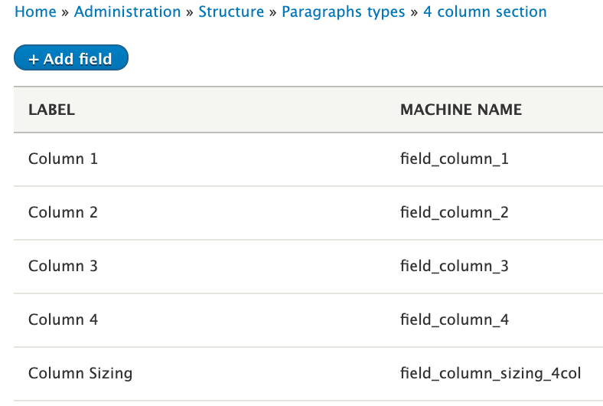
Sections > 1-4 Column Section > Allowed Types
Can customize which allowed types are allowed in each column of each variation (e.g. hero banner only allowed in 1-col)
Also allows you to theme very specifically (e.g. image in 1-col v. 4-col
Nesting of Paragraphs is crazy powerful but also increases complexity
Paragraphs Experimental form with Modals is a nice touch

Slide 24
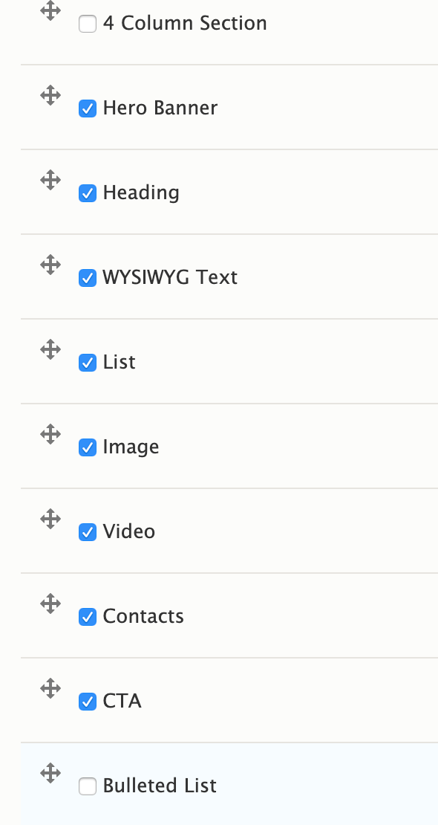
Each column in each section type can define allowed paragraph types
1-column section - hero banner + all others
2-4 column sections - all basic paragraph types
Using nesting for increased flexibility
Contacts - multi-value Contact (single) paragraph reference
Lists - bulleted, list with icon, list with icon per list item

Slide 25
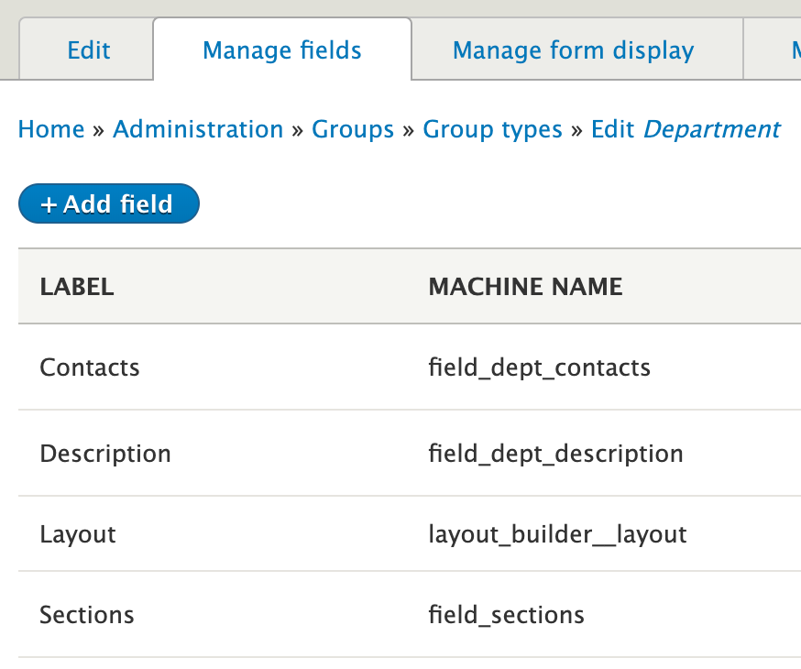
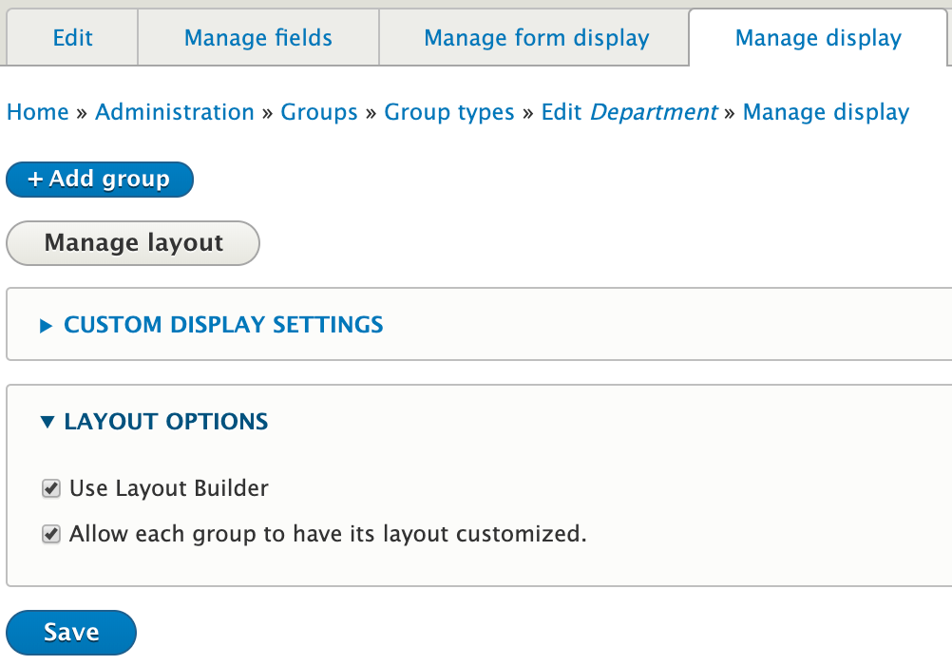
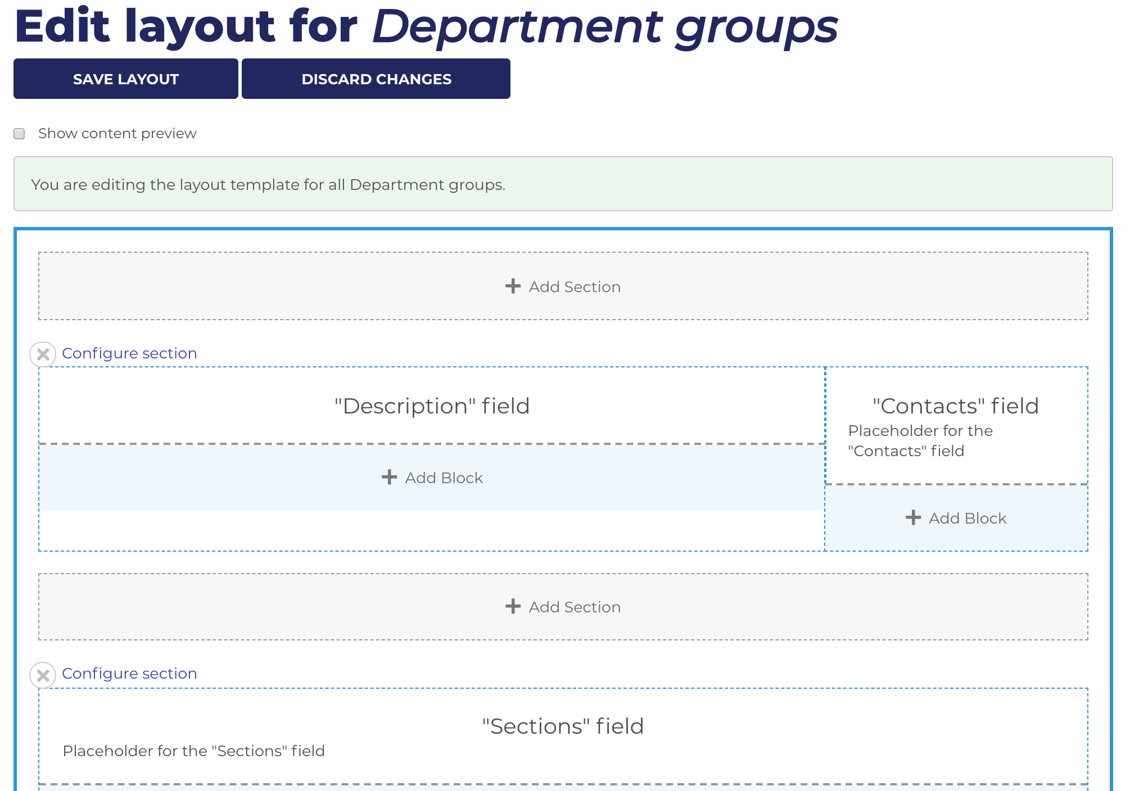
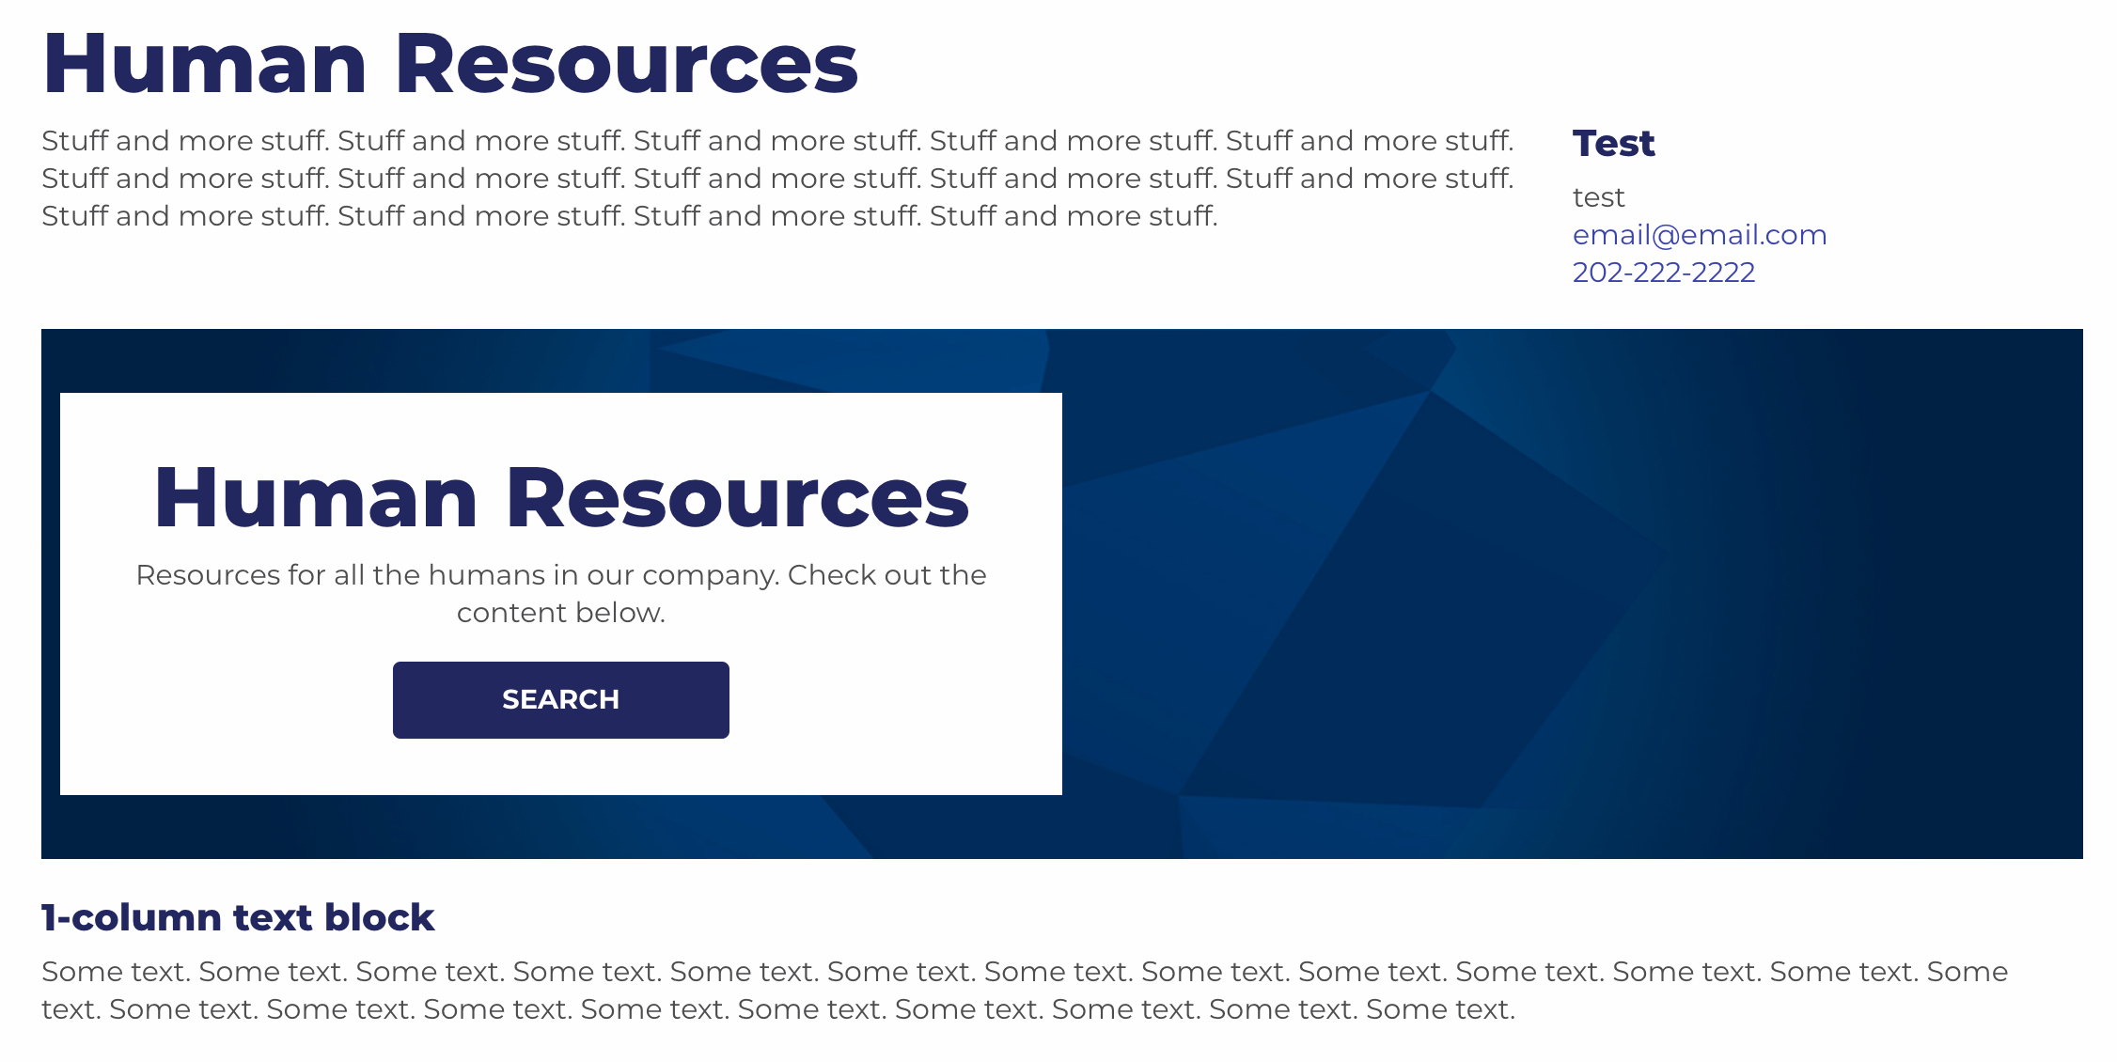
Set up Layout Builder, include any required fields where you want them by default, allow customization
Additional customizable content
Paragraphs fields, nested
Custom block types (w/paragraphs)

Slide 26
Expected Issues
Group content v. node, 2-step wizard
Need for menu_link module, allowed menus
Config management - group menus
Media browsing - no group context
Multilingual, content moderation
Things you may run into, especially with a more complex setup, possible approaches

Slide 27
“2-step wizard” can be confusing to even experienced users
Edit tab only edits the Group Content entity (not the actual node)
Use contextual links
Custom module (separate “edit relation”, “edit content” links)
After creating new related entity, may end up on new entity instead of group content entity
2-step wizard enabled - save takes you to group content
2-step wizard disabled - save takes you to node
Most likely you want to enable the wizard
Add Group Content entities to Group menus (NOT the node!)
URL field for the Group Content entity
Setting up role for new user when added to the group
Notes:
Even if you don’t use the auto-create option and manually add menus in dev for testing, this is problematic.

Slide 28
Menu link, Group menus, revisions
No direct support for menus in Group or Group Content - requires menu link (field) module
Group content entities support only related entities with integer ids
https://www.drupal.org/project/group/issues/2797793 - Entities identified by strings as group content
Revisions not supported out of the box
https://www.drupal.org/project/group/issues/2829966 - Support for revisions
https://www.drupal.org/project/group/issues/3030127 - Combined support for revisions and related entities with non-integer ids (menus)
Notes:
Even if you don’t use the auto-create option and manually add menus in dev for testing, this is problematic.

Slide 29
Menu Link field allowed menus
Group menu plugin for a Group type can be set to:
Automatically create a new menu for new Groups
Automatically create an initial link in new menus
New groups’ menus need to be added to the field as an allowed menu before you can add group_content to it
Menus you don’t want available are in the dropdown
Write a small custom module with a form_alter on field_menu_link which just sets the default menu as group-[group_id]-menu and disables the dropdown altogether
Notes:
Even if you don’t use the auto-create option and manually add menus in dev for testing, this is problematic.

Slide 30
Config management and group menus - Group menus disappear after deploying!
Group menu plugin - option to auto-create menu for each group
Menu_link fields on the group content - available menus need to have group menus available in order to place group content in them
Menus and field settings = configuration entities - when drush cex is run in dev/local, menus and fields are exported for deploy
Normally, production environments only run drush cim - missing config (menus built in prod but not on dev) are deleted
Enter Config Split - export specific config (group menus) to a folder before importing new config
Example new process drush csex menus, drush csex group_menu_link_field, drush cim
Notes:
Even if you don’t use the auto-create option and manually add menus in dev for testing, this is problematic.

Slide 31
Media browsing - group context
Media browser functionality has no concept of Group context - users see all media site-wide
Write custom module which intercepts Views’ access handler based on your needs
Get user’s groups (gids), only show media which is in the user’s groups
Also consider adding a boolean field (“flag”) on media to flag assets as “global”
Notes:
Even if you don’t use the auto-create option and manually add menus in dev for testing, this is problematic.

Slide 32
Multilingual and Content Moderation
Paragraphs are Entity Reference Revision field (not Entity Reference field)
Nested paragraphs makes this even more complex
Editing a Paragraphs attached to a Group does not trigger a revision to be created (works as expected with Paragraphs on nodes)
Needed patch to get Group to play nicely with Content Moderation
https://www.drupal.org/project/group/issues/2906085
Revisions for translated content are not displaying when in a Draft state
This is a limitation from Core and the bug is in here: https://www.drupal.org/project/drupal/issues/3036199
Oddly enough, enabling content moderation solved some issues with translations and entity reference revisions
Notes:
Even if you don’t use the auto-create option and manually add menus in dev for testing, this is problematic.

Slide 33
Links
(In)organic Groups - The D8 Group Module (2018 GovCon) (video)
Group - an alternative to Organic Groups
OS Training, Organizing users using Group
Phase2, Building community sites with Drupal 8
Acquia “module of the week” series - 1/31/17
DrupalEasy StreamCast - D8 Group module (video)
DrupalCon Vienna 2017 - DrupalCon Vienna 2017: Building social websites with Group and Open Social (video)
DrupalCamp St. Louis - Group: an alternative to Organic Groups (video)
Modules unraveled podcast # 158 (audio)
Setting Up User Groups Is Now Easier Than Ever
Acquia Module of the Week - January 2017
DrupalCon Baltimore: How we develop Organic Groups 8 after 2 years with Elm (@video)
Taxonomy as Organic Groups (video)

Slide 34
Notes:
WE’RE HIRING!!

