Slide 1
ReactJS and Drupal 8
Writing content rich JavaScript/REST web apps.
DrupalCamp Atlanta
Jitesh Doshi, SpinSpire
@spinspire_com
Screencast video and Source code for this presentation.

Slide 2
Motivation
Drupal is your favorite CMS
AJAX apps and SPA's are cool!
ReactJS is the HOTTEST thing (What? It's vue.js now?)
REST support: D7 contrib, D8 core
D8's Content + React's UX == Awesome!

Slide 3
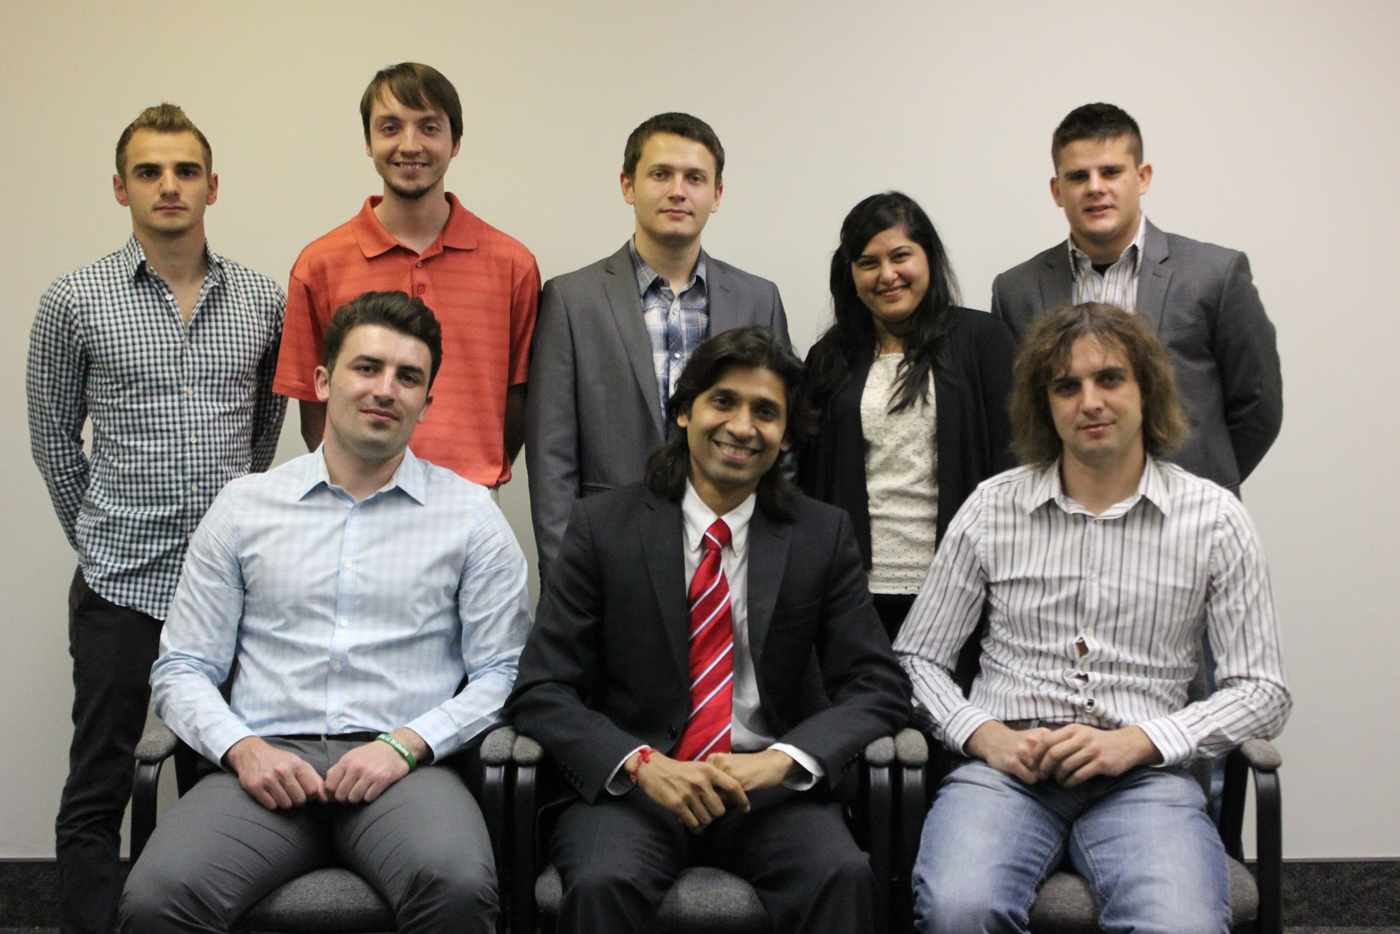

Slide 4

SpinSpire is a Drupal focused company.
All developers located in Jacksonville, Florida.
Contributed modules: popular_tags & prlp.
Clients such as Nike, Florida Blue and Federal Govt.
Find us on the web, or visit https://spinspire.com/

Slide 5
ReactJS key facts
Not full MVC, only View.
Has addons for other stuff - routing, state mgmt, ajax...
Uses "Virtual DOM" for performance.
Lets you build components that can be injected DOM and updated when state changes.
Best used with ES6 or ES2015 which compiles to JS.

Slide 6
Setup
Install D8 and some basic modules
  drush dl devel admin_toolbar pathauto token ctools
  drush -y en devel devel_generate admin_toolbar_tools pathauto
  drush -y en rest
Generate some users, terms and nodes
  drush generate-users 10
  drush generate-terms tags 10
  drush generate-content 50 0 --types=article

Slide 7
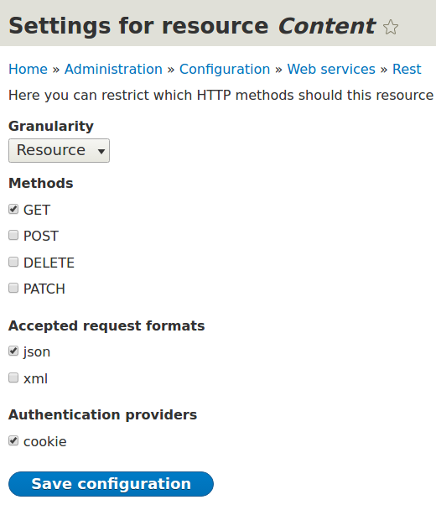
Enabling Content serving as JSON
drush -y en restui rest serialization
Visit Configuration > Web Services > REST
Enable "Content"

Slide 8
RESTful services in Drupal 8
GET http://localhost/node/1?_format=json
POST http://localhost/entity/node
PATCH http://localhost/node/1
DELETE http://localhost/node/1
Create views and add "REST export" display.
GET http://localhost/node/rest
And much more!!!

Slide 9
Drupal 8 - CSRF and Authentication
JavaScript code should get CRSF token from /rest/session/token
Include token as X-CSRF-Token in all requests
JS app deployed to a subdomain of D8
So that authentication cookie can be shared
Configure Drupal REST to use cookie auth

Slide 10
Drupal 8 - CORS
Configure cors.config in services.yml.
cors.config:
enabled: true
allowedHeaders: ['x-csrf-token', 'content-type']
allowedMethods: ['GET','POST','PATCH', 'DELETE']
allowedOrigins: ['*']
supportsCredentials: true

Slide 11
Recipe: ReactJS App in Drupal 8
Use this demo app as the starting point
Deploy Drupal 8 to localhost.d8 and this app at app.localhost.d8 (a subdomain)
Develop and test React app in standalone mode. Use webpack dev server with hot-reloading.
Compile to dist with "npm run build"
Finally, add a block in Drupal that embed React App.

Slide 12
ReactJS App Development
Install npm.
Follow a productive dev workflow using webpack-dev-server.
Implement basic ReactJS components.
Implement basic state management - App is the only stateful component. All others are pure functional.
Use axios for AJAX requests. Configure it to include X-CSRF-Header and credentials cookie.

Slide 13
For More Information
Screencast Video: https://youtu.be/UwCX9oPpfPI
Source code: https://bitbucket.org/spinspire/d8-react
Email: jitesh@spinspire.com
Follow @spinspire_com
Visit spinspire.com
Visit youtube.com/spinspire
Questions?

