Slide 1
Beyond Content Management Drupal as a foundation for web applications
LocalTennisLeagues.com, a case study

Slide 2
Hi, I’m Scot Self
Yes, Scot with one T
Drupal Front End Developer, Site Builder, Budding Module Developer
Occasional contributor, active community member
Principal, Inner File Software
Live in Pinson, AL (Outside of Birmingham)
Married 17 years (Daphne, college sweetheart), 2 kids (Juniper – 8, Tristan – 6)

Slide 3
Meet our client, Local Tennis Leagues
Largest tennis league organization in the United Kingdom
Secured funding (4-year deal) from the LTA (Lawn Tennis Association), the national governing tennis body for the UK.
Over 8,000 active players (active Drupal accounts).
We developed a two-phase plan
Phase one: Upgrade to Drupal 7, design new theme, integrate with FileMaker database
Phase two: Goodbye FileMaker, hello Drupal web-app

Slide 4
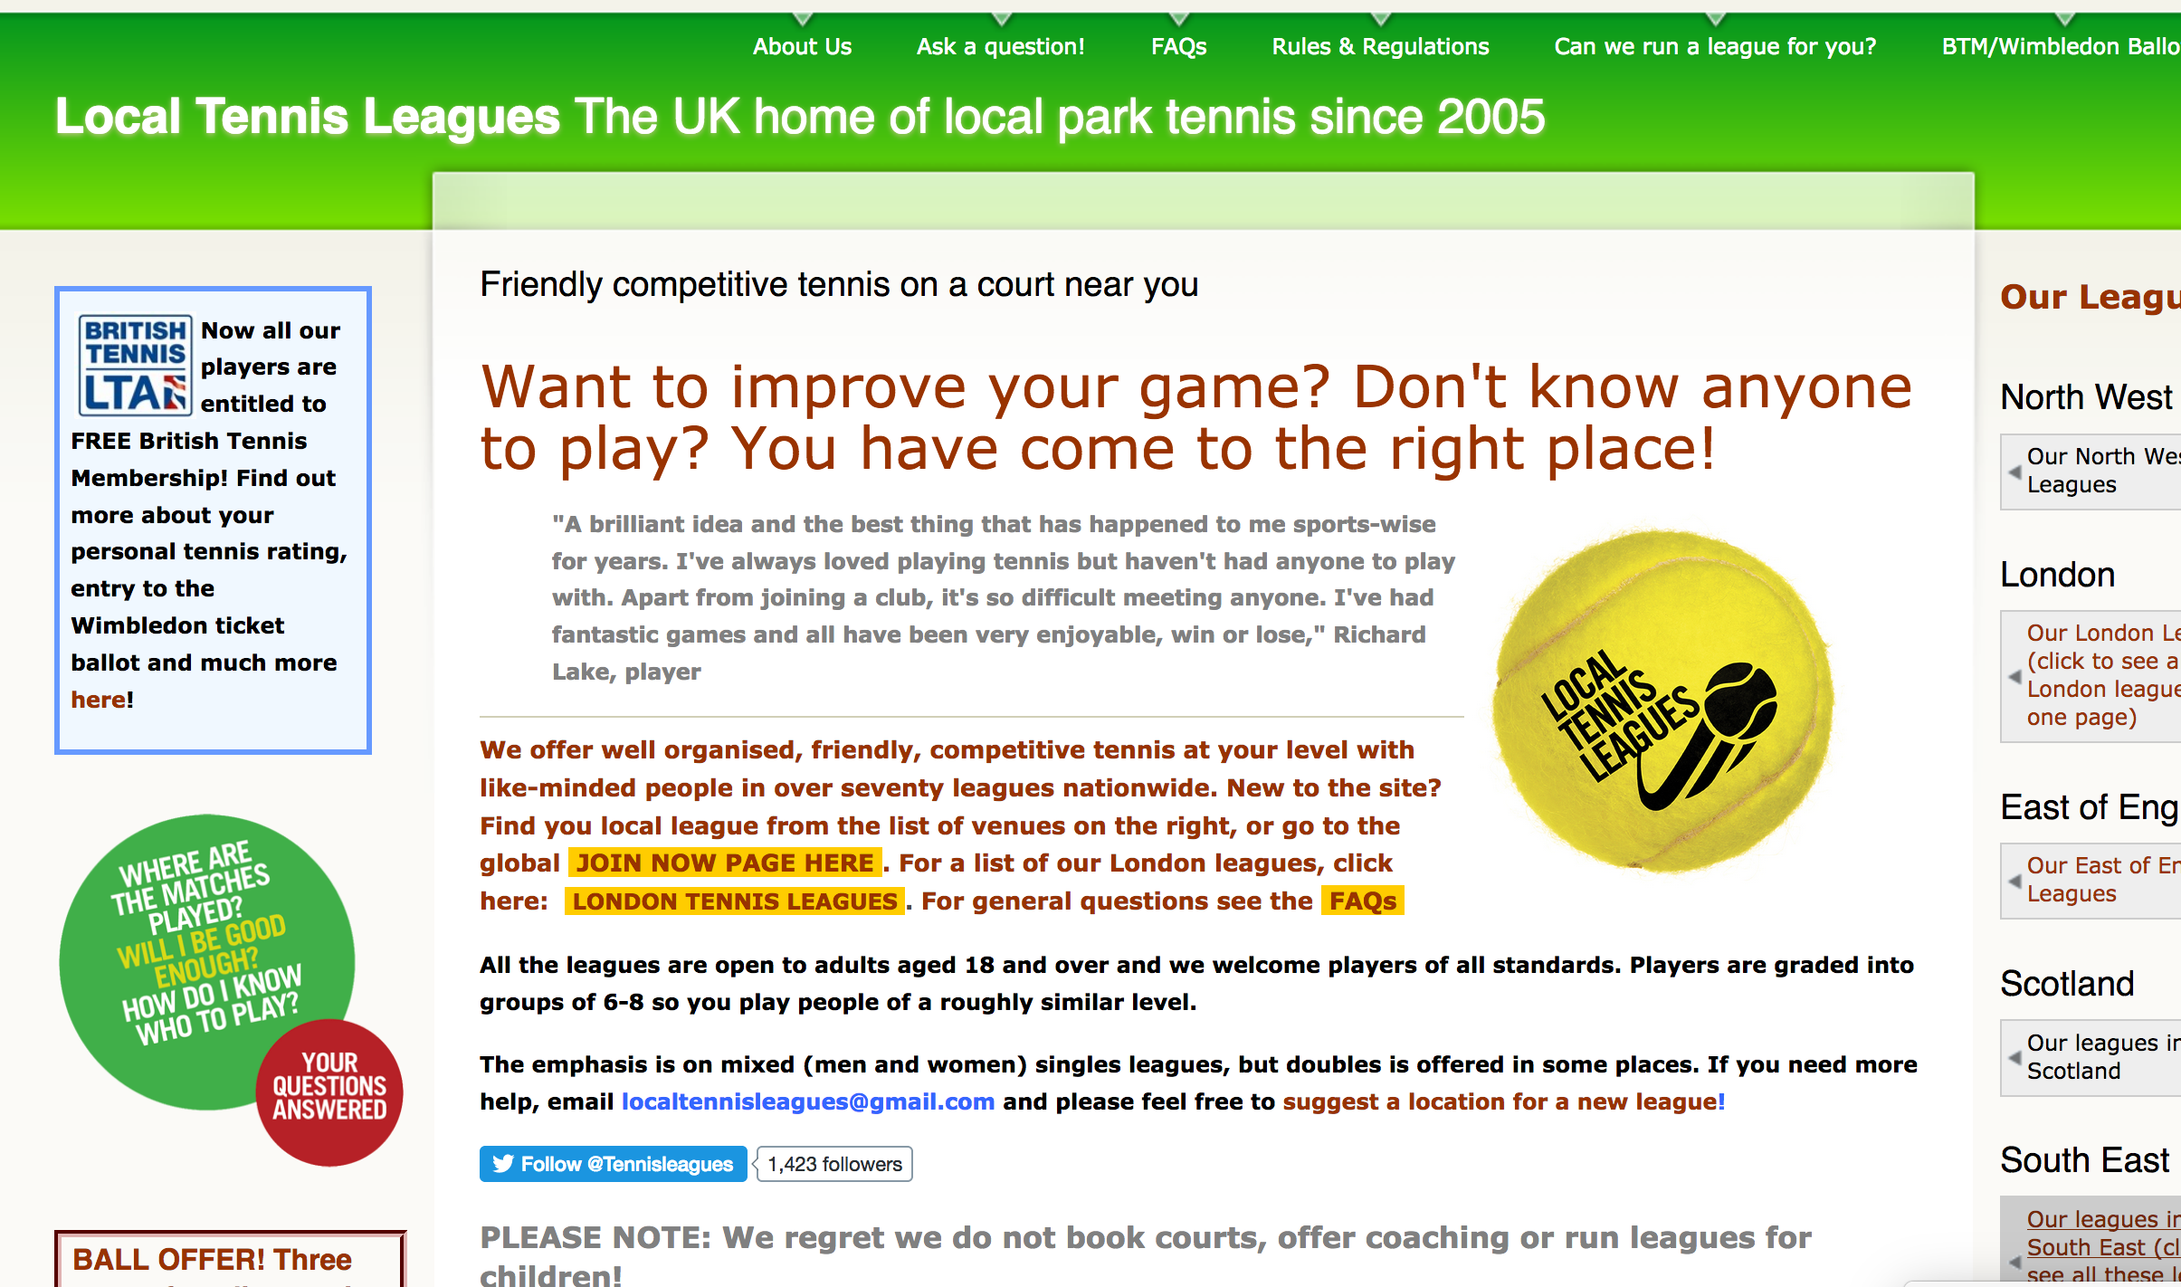
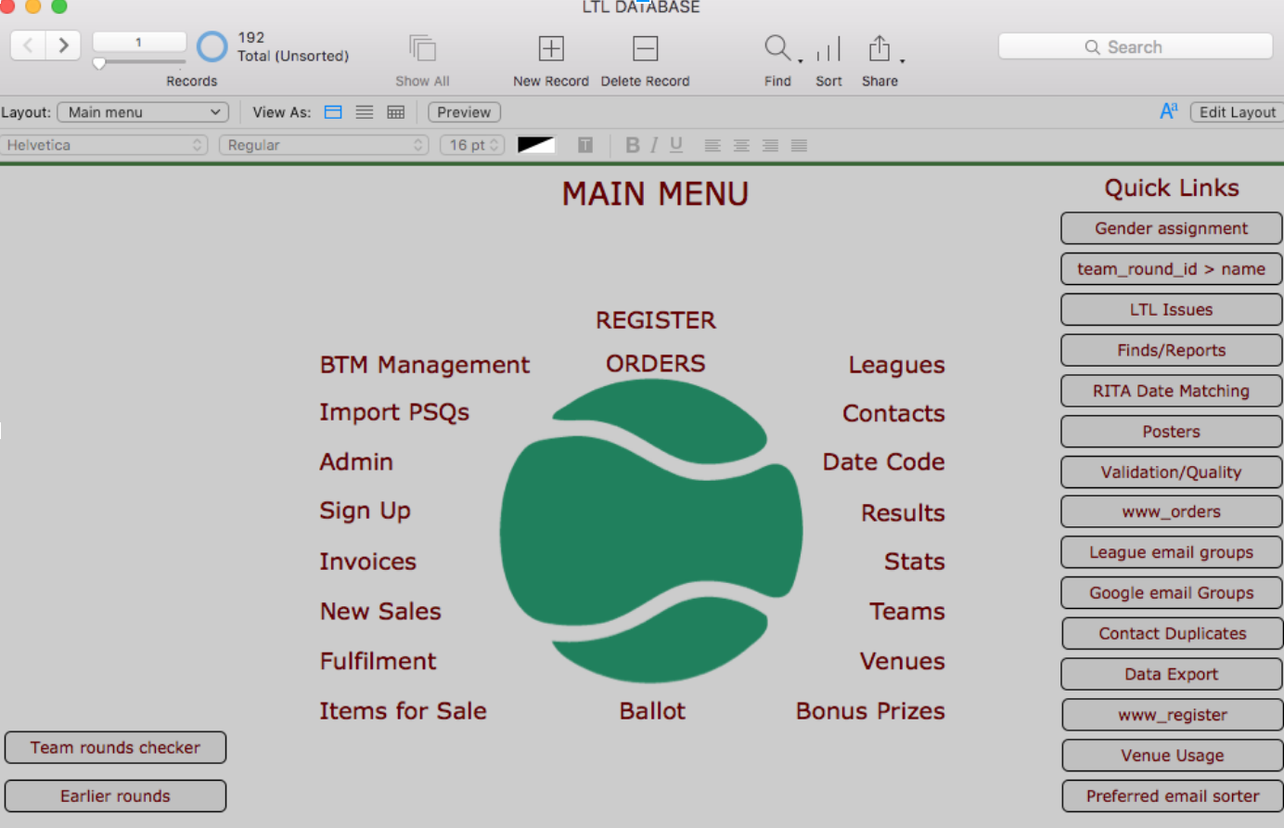
The Bad Old Days
Drupal 6
Front-end website only
Not leveraging Drupal
Players didn’t log in
Not using any of Drupal’s e-commerce tools
However, they LOVED webforms
Drupal 6 was nearing end of life
FileMaker
Huge Database, filled with complex business logic
D6 score score reporting flow: Drupal (Webform) > FM > Drupal (HTML block)
Cron pushing to and pulling data from FM (date blocks – block_export_import/ltlcron, ltlarchiveround, ltlregister, general-purpose ltlfilemaker glue module)
Gmail
Send out thousands of e-mails manually, no longer manageable

Slide 5
Phase One
Design new theme/brand/look
Upgrade to Drupal 7
Integrate with FileMaker database
MadeByWe(.org) (so good, go hire them!)

Slide 6
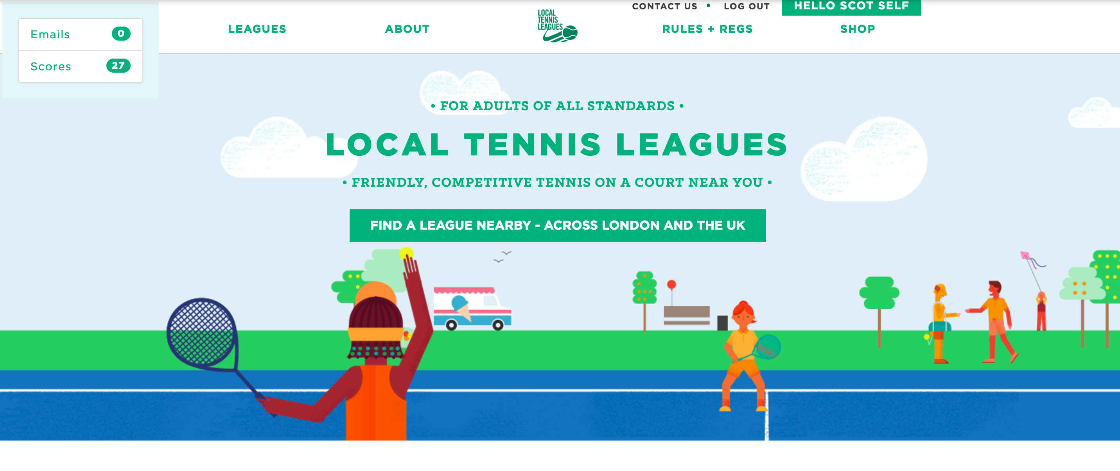

Slide 7
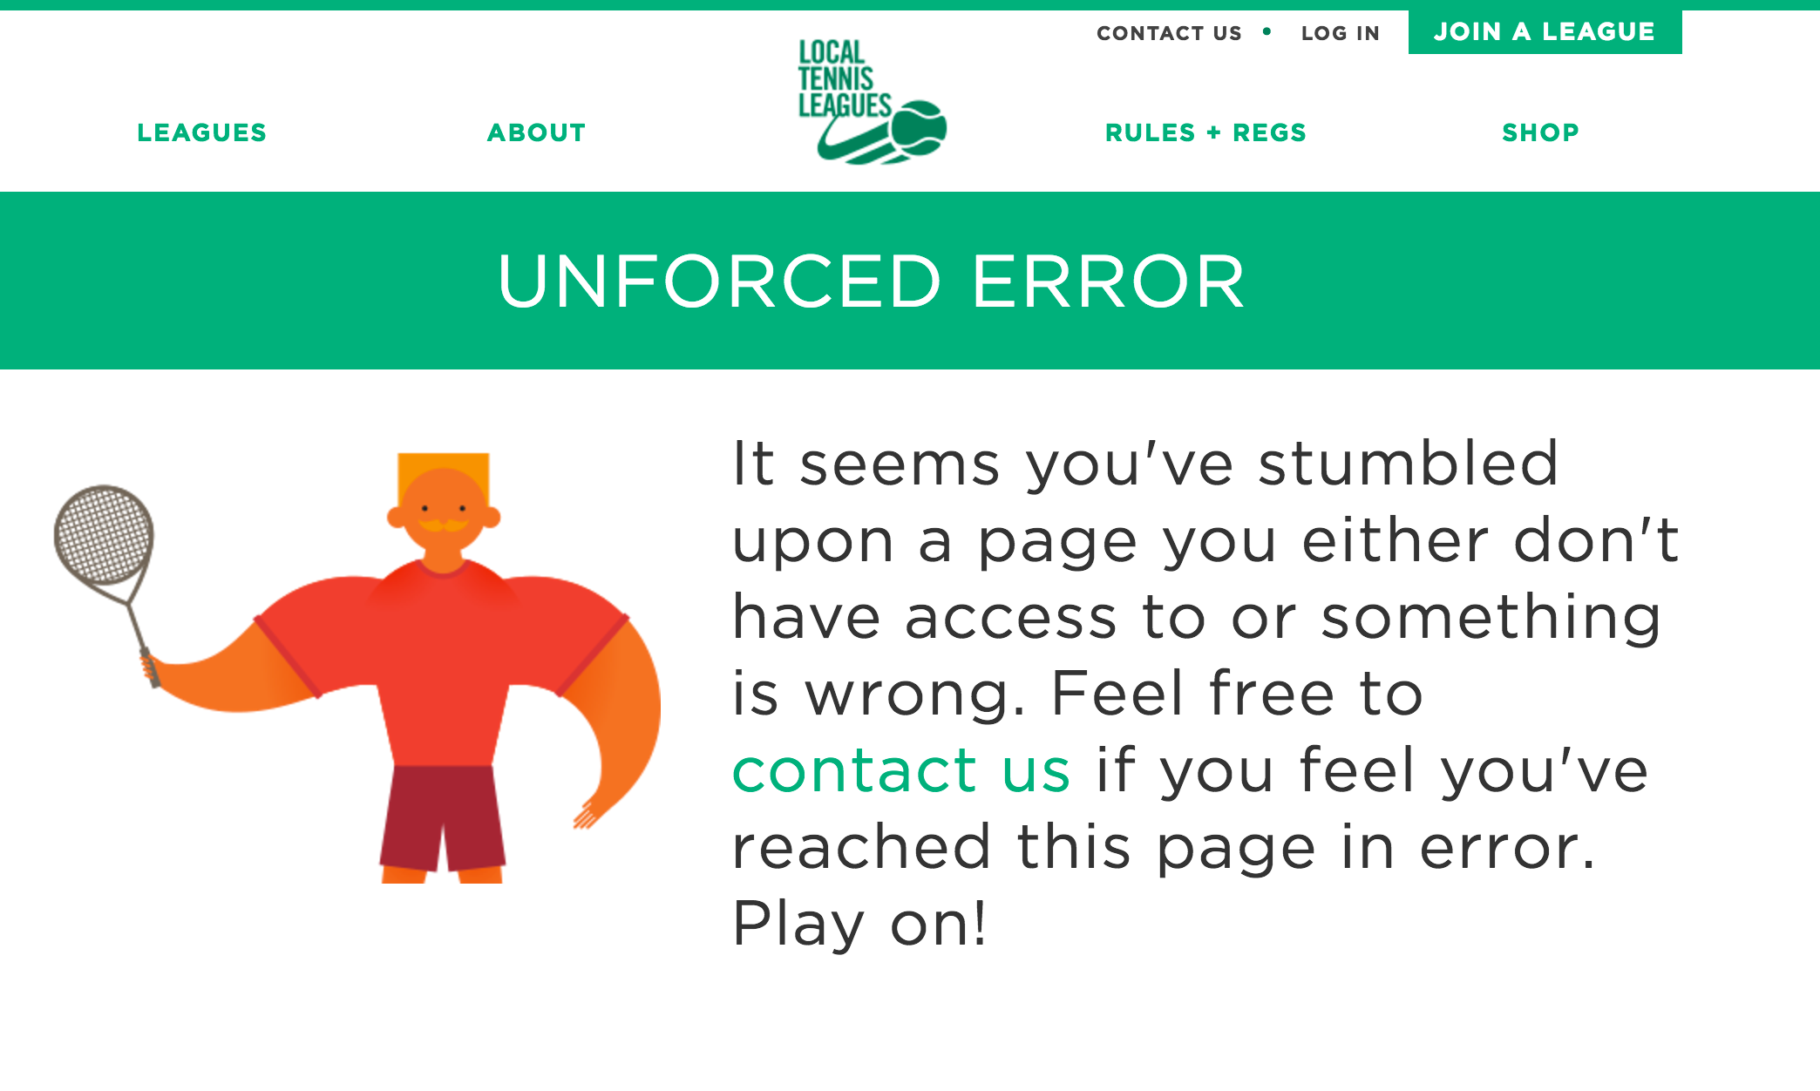
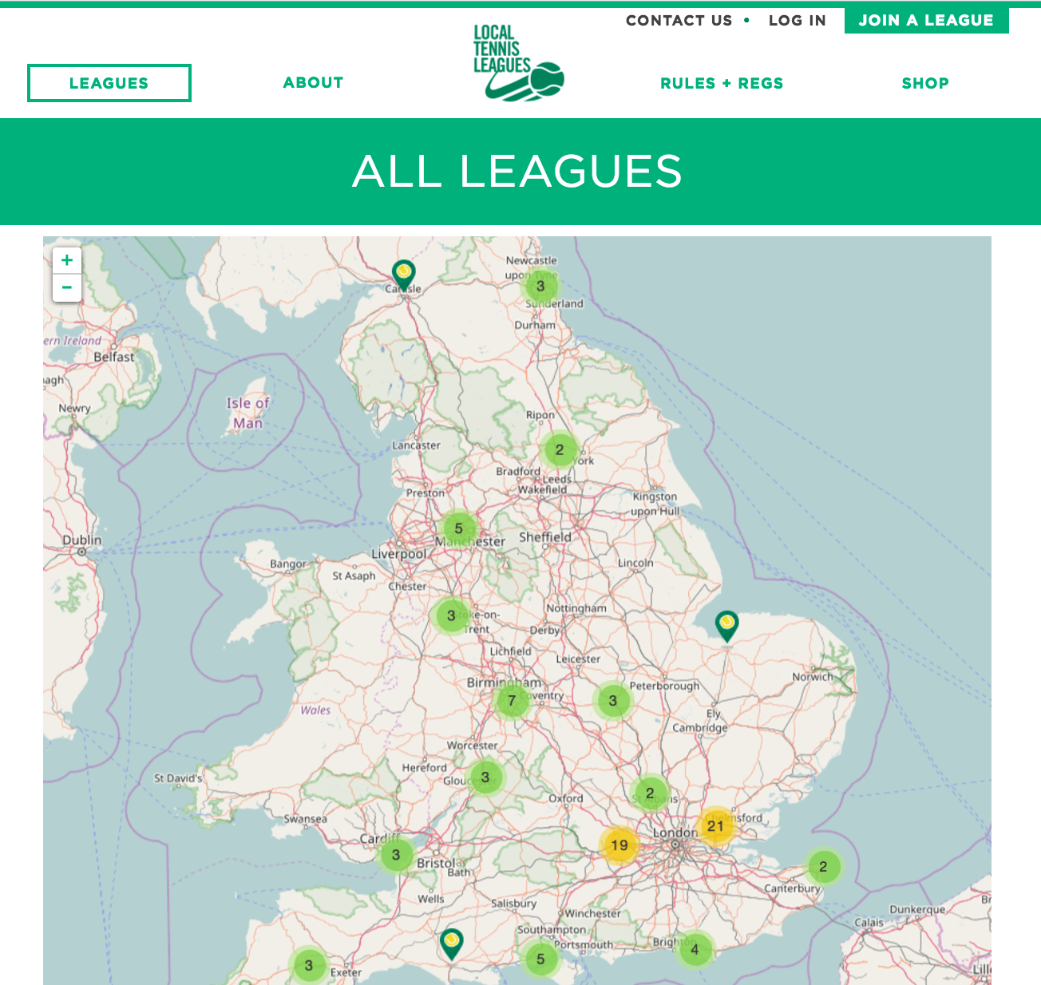
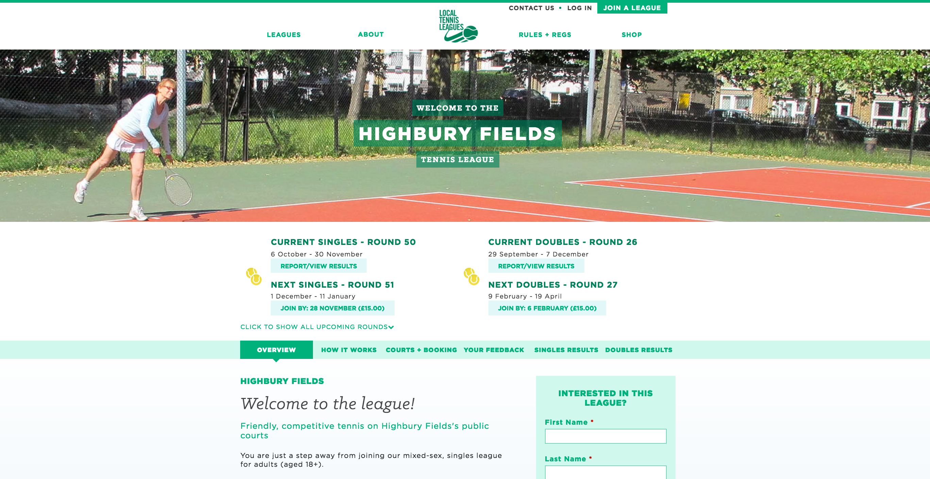

Slide 8
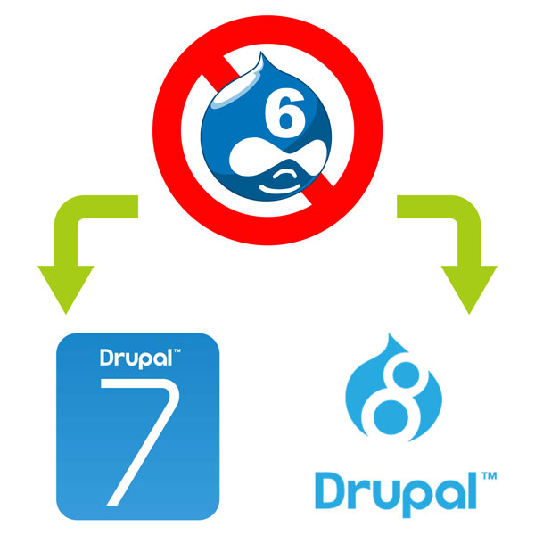
Upgrade to Drupal 7
Drupal 8 was not out yet
Needed mature contrib ecosystem
Minor data migration
Client recreated base content/copy
Users out of FileMaker database

Slide 9
Integrate Drupal with FileMaker database
FX.php (by iViking) – Excellent PHP API for interacting with FileMaker
Authored several custom modules
Respond to questionnaire completion (ltlregister)
Score reporting form (ltlmatchreporting)
Extra score validation (surprisingly complex)
Proof of concept for phase two: users assuming data entry burdens (umm, we mean users empowered through a web app!)
Players came from FileMaker, as a CSV file (ltlcron, ltlfilemaker)
Feed Importer => “Match Reporting CSV” Nodes to build select list.
Delete all and rebuild on every cron run.
Everything worked, but was always somewhat clunky and slow

Slide 10
We actually specialize in integrating Drupal & FileMaker
Ninja Girl, and her sidekick Turtle (her pet cat), make Open Source Art
Go buy some Art! Or commission your own like we did!
Any guess as to what these art pieces are about?
ninjagrl.com (No ”i” in grl)

Slide 11
Phase two: Goodbye FileMaker, hello Drupal web-app
One database is better than two
Users go to website to do data entry and view results, no benefit to back-office database
HUGE UNDERTAKING

Slide 12
What does it mean to go “beyond a content management system?”
Hard question to answer, no clear, defining line between a CMS and a Web App
All systems just manage data
However, these hint at more than a CMS:
Button that creates hundreds or thousands of nodes at one click
Forms requiring thousands of lines of validation code
Sending hundreds of automated e-mails each morning, using very sophisticated logic
Less than straight-forward E-commerce, deeply coupled with non-store data``
Multiple complex algorithms for ranking and sorting
Entire business dependent on the site and customers’ and admin interactions with it.
If the reasons seem to point to “more than a CMS”, why build in Drupal? Our train of thought…

Slide 13
Drupal vs. frameworks Laravel is fast to develop in
MVC – OOP – operate under a standardized, well-understood programming structure
All in code, under version control without requiring Features, including models (data, DB queries), views (rendering of components for viewing or modifying) and controller (logical operations) of course, but also migrations (data structure), seeds (data to “ingest”).
Drupal content types don’t explicitly know about relationships, ORM models do (can). In Drupal, have to rebuild same relationships over and over in Views or through joins in a query. ORM model can just have related data as a property of itself.
HTML Views are much nicer than Drupal .tpl files (blade!) to work with.

Slide 14
Drupal vs. frameworks Drupal is fast to develop in
Freebies from choosing Drupal
User Accounts (and sign up/in/pwd reset)
Content Types, Fields (limited types in core, but separate display config)
Commenting, Book, Blog
Contact Forms
Forum? Poll?
Taxonomy
Menus
Blocks
Themes
Watchdog
Sophisticated auth and permissions, with a UI.
Hook system for custom code
Drupal community is without parallel – support!

Slide 15
Drupal vs. frameworks Laravel is faster at runtime
node_load($round_nid) vs $Round::load($id)
node_load() hits a BUNCH of tables, with SLOW joins. Each field == its own table (plus revisions).
Round::load() hits only the round table, unless configured otherwise.

Slide 16
Drupal vs. frameworks Drupal is faster at run time than a framework
Drupal vs. frameworks Drupal is can be about as fast at run time as a framework
This is so not true. Drupal is slower.
Lots of options; scaling Drupal is a solved problem.
OpCode caching (APC – Advanced PHP Cache)
Database caching (Memcache)
Proxy caching/HTTP Acceleration (Varnish)
Boost (anon traffic)
https://www.drupal.org/docs/7/managing-site-performance-and-scalability/caching-to-improve-performance/caching-overview

Slide 17
Drupal vs. frameworks Laravel pros final
Quite a decent eco-system of plugins which solve common problems (Auth, Eloquent ORM, Cashier (Stripe), Socialite), lots of helper functions, good docs.
Draw from all of PHP (packagist, composer.json require).
Big picture:
Drupal often does (can do) a lot more than your app needs/wants to do, making it much slower than a lean app developed in a framework. Also requires wrestling with core and contrib.

Slide 18
Drupal vs. frameworks Drupal pros final
Contrib space is unbelievable
Field Type - Entity Reference (prepopulate), Email, Link,
Views + - w/VBO, EVA, RSS, Pivot, Calc, Aggregator, Data Export, Slideshow options
CKEditor
Commerce
Auto Node Title, Leaflet, Twitter…
Auth and permissions are sophisticated, and free, with a UI
Again, Drupal community is without parallel!

Slide 19
Drupal vs. frameworks Laravel, Symfony, etc.
Was Drupal the best possible choice?
Honestly, we can never know. Both would have worked wonderfully.
Drupal was an excellent choice for this project.
Custom VBOs / DrupalQueue
Drupal Commerce suite of contrib modules
Permissions and roles were helpful throughout
Fast permissions Administration module helpful for huge projects (too many permissions, can’t save changes to them).
Client learned Views, is fully empowered to create reports and listings
Mature contrib ecosystem was key. A project like this would be impossible in Drupal 8 right now. Might as well write from scratch in Laravel.
Site is already in Drupal. Regardless of the complexities that make this a “web app”, this is a major factor.

Slide 20
Reducing administrative burden in a rapidly-expanding enterprise
D6 days, they were running approximately 65 leagues and by the time Phase II was underway this had grown by 130% to 165 and has continued since.
The administrative burden largely revolved around 2 key issues:
Communications with players - email each player of each round, check in if they haven’t played any matches, let them know when they earned a bonus prize, etc.
Managing bonus and winner’s prizes and fulfillment thereof.

Slide 21
What we’ve accomplished
After over a year of hard work on both the part of the LTL and IFS Teams, we accomplished a lot. Pulling FileMaker out of the equation, we have pulled every essential piece of data out and seamlessly merged it into Drupal.
Data migration
Group Assignment
Score reporting & approval
Non-standard commerce needs
Email templating system, cron/DrupalQueue essential

Slide 22
Data Migration
Reduced the system from two databases to one: No more FileMaker!
Since all the data is already in there, use FileMaker as the middleware, create php arrays from existing data for ingestion. All data pre-formatted for Drupal.
Use current production as the base.
Don’t have to change (League or other) existing nids, which have value in migration, league_nids in FM
Use features to deploy developed structural components into copy of prod.
Iterative testing of data integrity.
17,968 unique Players from past and current round participation, interested
Create and/or update Drupal accounts from FM data.
2.5 hr batch job.
Add to Mailchimp list with league segment.
Mostly authenticated users, some logging in within moments of launching to report scores, 120+ scores overnight (10p-4a London).
2,506 Rounds, made up of 3,565 Groups of Teams
25,397 Teams, unique round-specific (singles or doubles), their statistics in the round, Win/Loss, etc.
78, 015 Match results/Scores with commentary, displayed on each round page
One call back for each type 1 big php array from FM (8 files of 10,000 matches each) ltl-import/[type]

Slide 23
Group Assignment
List of all signups to curate into the round’s group makeup.
Advanced statistics from previous rounds (pos in group/round, % calc).
Direct links to previous round, team, league.
Access to player questionnaire data.
Administrative notes (player profile, group assignment notes)
Merge doubles functionality, players on multiple teams (but different groups).
Allow for late joiners.
Made to look like their previous FileMaker screen they are used to working in (prepare yourself)…

Slide 25
Score Reporting & Approval
Most complete validation of 2 tennis formats’ scores (short and long) we’re aware of. Make it impossible to screw up and enter an invalid score.
Scores queued up for administrative approval
Custom message token for each reported score’s email generated. Update custom text in bulk.
Approved scores (using batch API) checks if they qualified for bonus points.
E-mail notifications sent when approved, contextual on status of approved match.
Reported scores queued for approval in admin notifications area.
Dispute form for score correction requests
Prepopulate all details from a match in a webform with a single textarea for details.
Easy to do for the player (comes up a lot).
Easy to process in Drupal (points have to be recomputed, matches are not RE-validated).
TeamSorter class which takes a group within a round and resolves any tiebreak situations. The level of complexity of resolving tiebreaks in this environment was surprising, to say the least.

Slide 26
E-mail templating system and DrupalQueue Integration
Administrative time suck, now as automated as possible.
Automated response to the questionnaire submission, depending on their preferred league (then create an account, add to Mailchimp, take to league home page of choice).
Round signup – New, Returning, Late joiner – new/returning
Late joiner - notify opponents
Doubles partner token (pay for your partner)
Reminder emails (1, 2, 3 weeks before end)
Chasers (teams who haven't played any matches by 1) 1 week before midpoint, 2) on the midpoint and 3) 3 wks before the end of the round)

Slide 27
E-mail templating system (cont.) and DrupalQueue Integration
Round launch email with customizable round-specific text.
Notifications to participants just prior to round midpoint
Notifications just after the round has ended to remind players to submit outstanding scores before the round is closed the official, finalized Round Report has been sent out.
Score Approval – normal score, retirement, walkover, TBC
Bonus Prize awarded – report 3 scores before midpoint
Winner’s process - congratulations along with coupon code to group winner.
Round report - summary of all the groups in the round, rankings, round-specific text, group-specific summary, winner/runner-up, comment and match of the group. Queued for approval in admin notifications area.

Slide 28
E-mail templating system (cont.) and DrupalQueue Integration
MailChimp / Mandrill
Drupal/sendmail often not enough for a site which sends frequent and meaningful e-mails.
Already invested in MailChimp for campaigns, transactional e-mails via Mandrill was a fairly natural move.
Gains in efficiency by automating regular e-mails easily outweighed the cost.
Visitors can express their interest in a league (get on the e-mail list for that league) and are automatically added to the correct MailChimp list segment

Slide 29
Commerce
Round signup for current and future rounds
Bonus prize system
Winner's prize coupons
Doubles tokens, pay for your partner
Basic shipping/fulfillment capabilities, export to other software for label printing

Slide 30
Places we had to write code where contrib surprised us and cost us hours/days/weeks
Coupons - custom code to handle fairly common use case - a single item of a specific type for free while not making all other items in your cart of that type free as well.
Editable Views and VBO - not BFFs -- adding editable fields manually in your module via the FAPI is the freaking worst.

Slide 31
Places we didn’t have to write code where contrib surprised us and saved us hours/days/weeks
Devel - don’t even attempt to debug without it.
Note: beware of dpm’ing objects with tons of data (our Round class). dpms can annoyingly (and silently!) fail, and you may have to dpm a smaller, more specific bit of the object to see it
e.g. dpm($Round) fails silently, dpm($Round->matches) dpms just fine (only 200+ nodes)
Drush - the command line is your friend. Embrace it.
Custom VBOs - super-powerful (approve/reject scores en masse)
Batch operations (Execute arbitrary PHP, Modify Entity Values)
Drupal Queue (for cron worker functions)
Computed Fields (Opponent, Score Display) - code can be stored in the module and under version control
Mandrill/MailChimp - replaces Drupal’s mail system, does it well. Integrate custom fields in Drupal with mail merge fields (League Interest) in MailChimp Lists.
Views Data Export - reconcile Drupal data against external data sources (csvs made easy), importable file of data for a separate label printing program. Any suggestions?

Slide 32
What’s left to be done
BTM (British Tennis Membership) integration - sync regularly with the LTA’s official membership list, particularly those associating their BTM with LTL.
More complete fulfillment setup - make shipping packages more seamless.
Automated testing (insurance) - is it worth it, client of this size? We don’t know, it’s contextual, most clients don’t want to pony up, even to protect their investment. Entire business depends on this being right, though…
No DB caching, redundancy, scripted backups. Just digital ocean scheduled weekly backup.

Slide 33
Questions?

